Slide 1



INSTITUTE for
Driplines of light nuclei in Nuclear Lattice Effective Field Theory and other works in progress
Frontiers in Nuclear Physics Workshop
BCTP, Bonn, Germany
Young-Ho Song

Slide 2


목차
Introduction
Nuclear Lattice Effective Field Theory
Wave Function Matching method
Results
Works in Progress
Summary

Slide 3
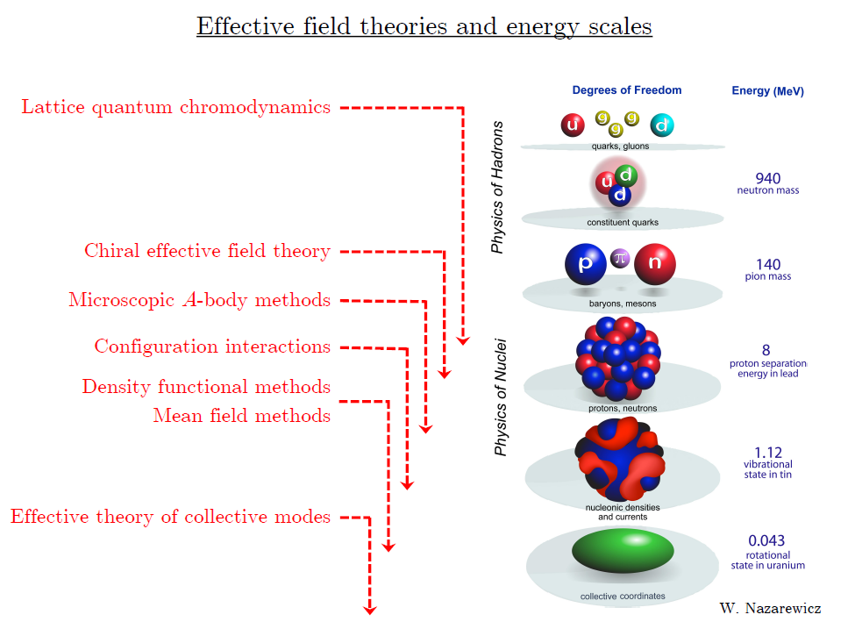
1. Introduction

Slide 4
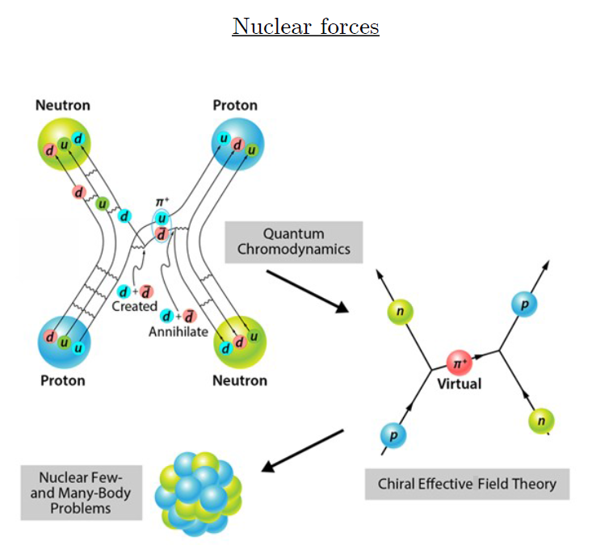
1. Introduction
ab-initio Nuclear Physics
(1) nucleon degrees of freedom
(2) nucleon-nucleon interaction
Goal: predict wide range(structure, reaction, nuclear matter) of nuclear phenomena (without parameter fitting, model assumption) from nuclear interaction (for 2-body,3-body, many-body, based on QCD)
Direct connection between
Nuclear Force ↔ Experiments

Slide 5
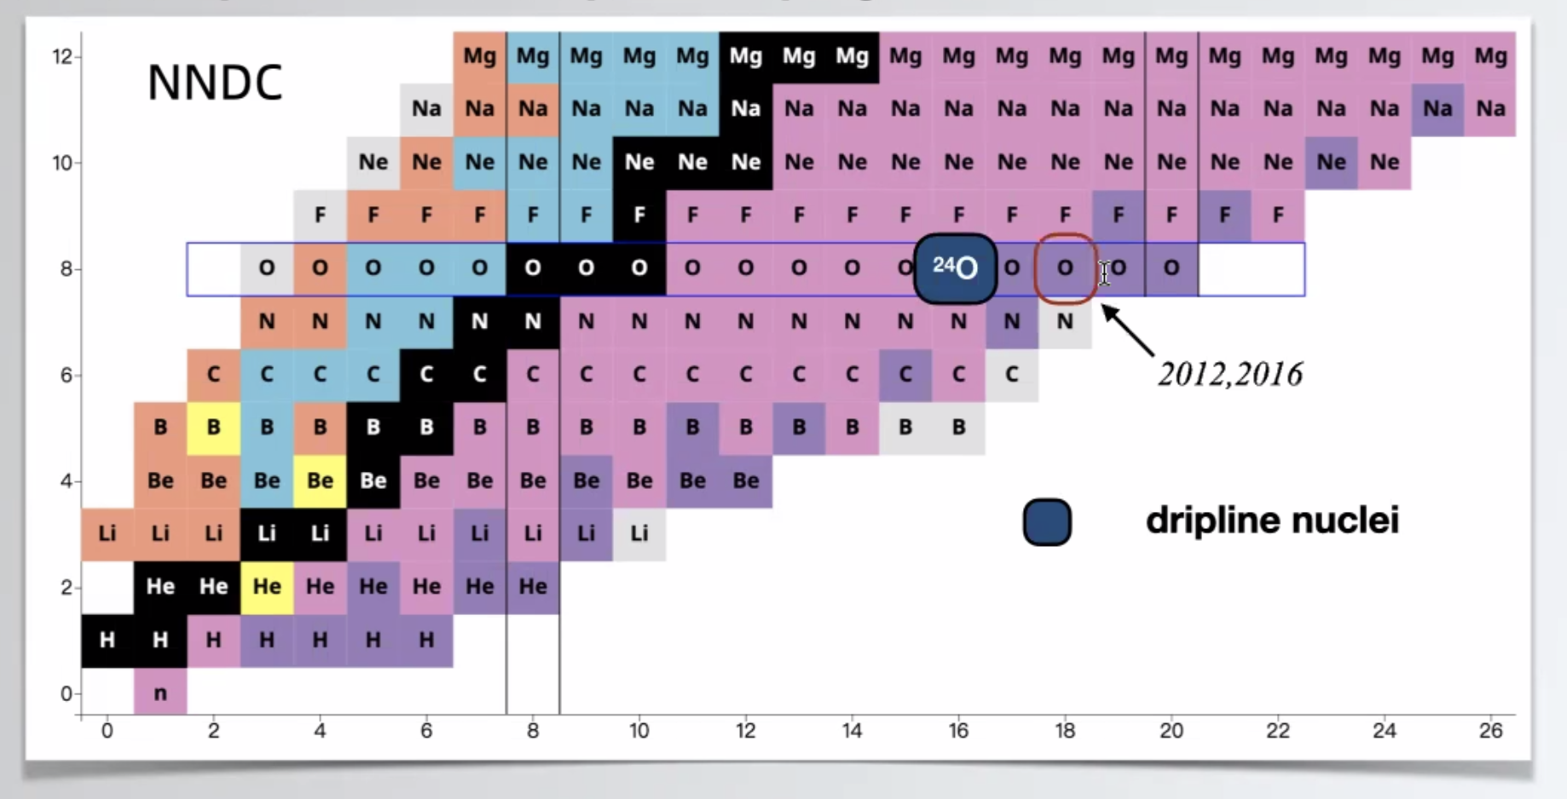
1. Introduction
Can we explain the dripline of Carbon, Oxygen isotopes in NLEFT?
Sensitivity to nuclear force ? (Role of 3-body force?)
Predict dripline near Astrophysical r-process?

Slide 6
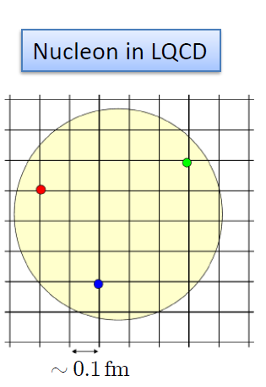
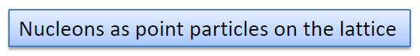
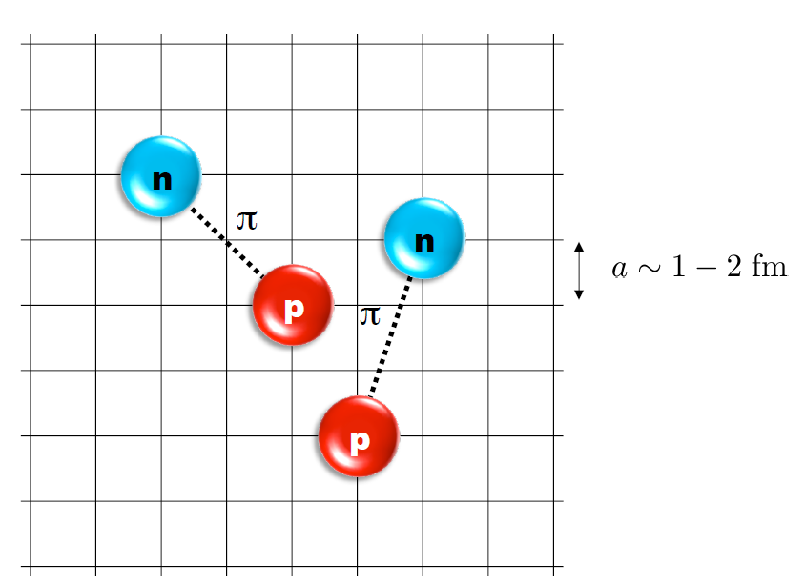
2. Nuclear Lattice Effective Field Theory
One of ab initio method for many fermion system

Slide 7
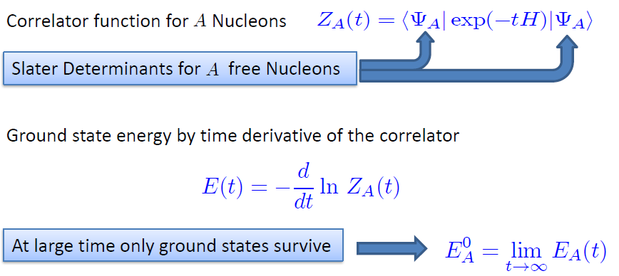
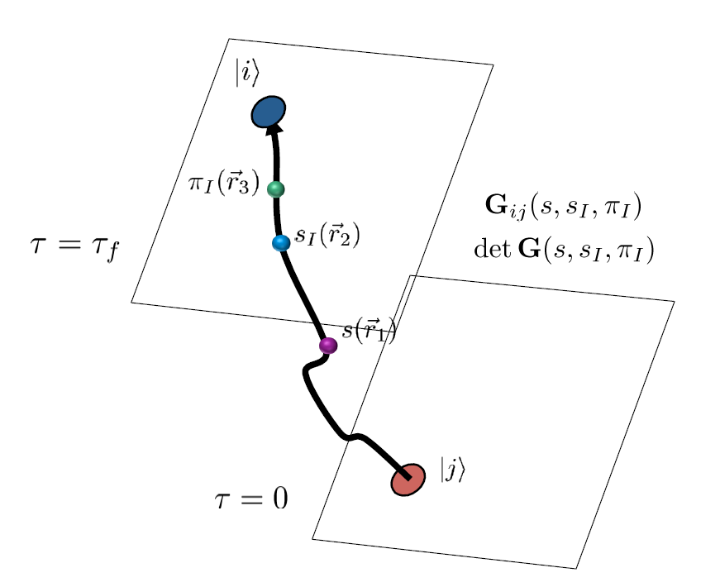
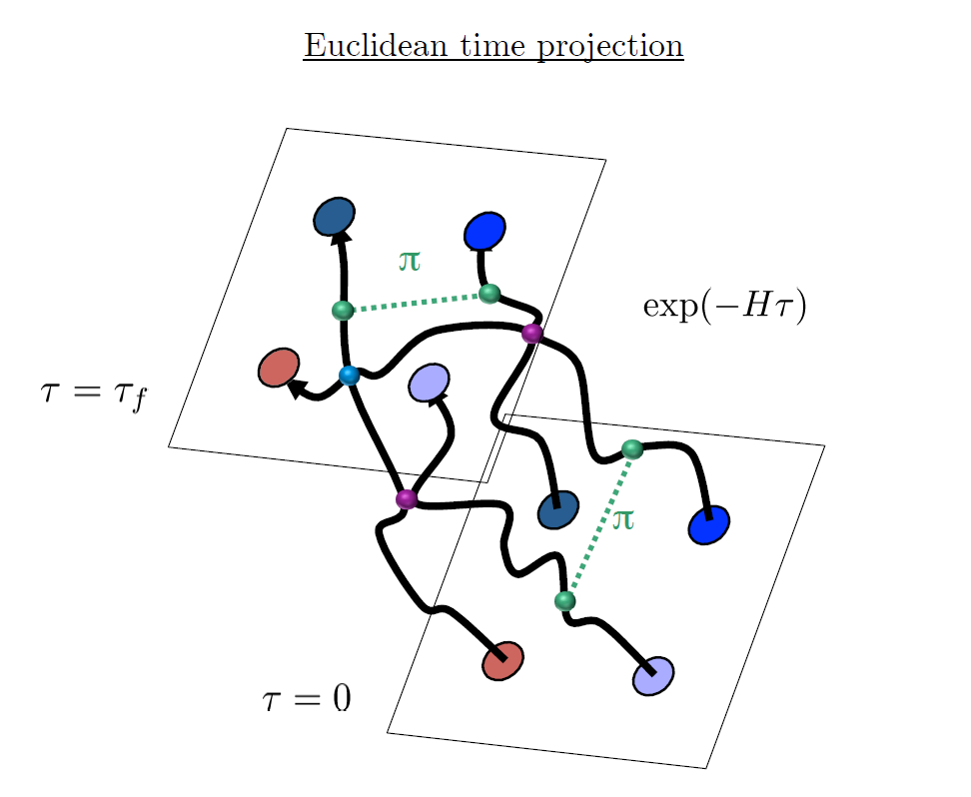
2. Nuclear Lattice Effective Field Theory

Slide 8
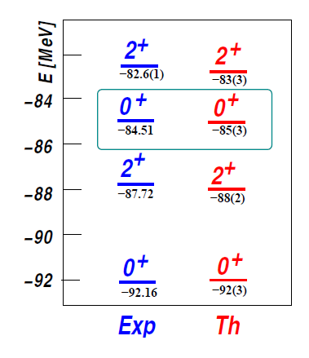
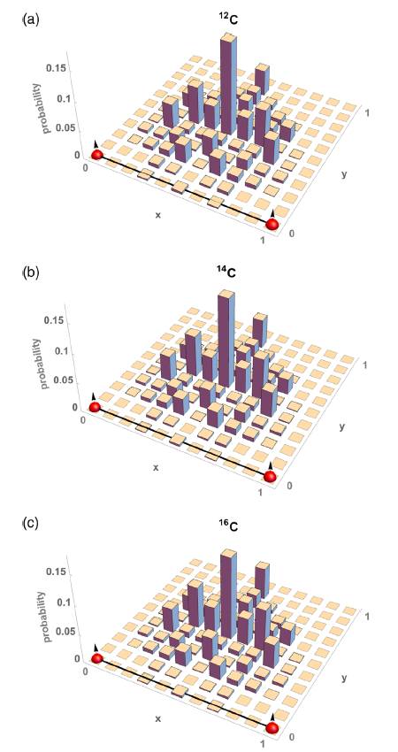
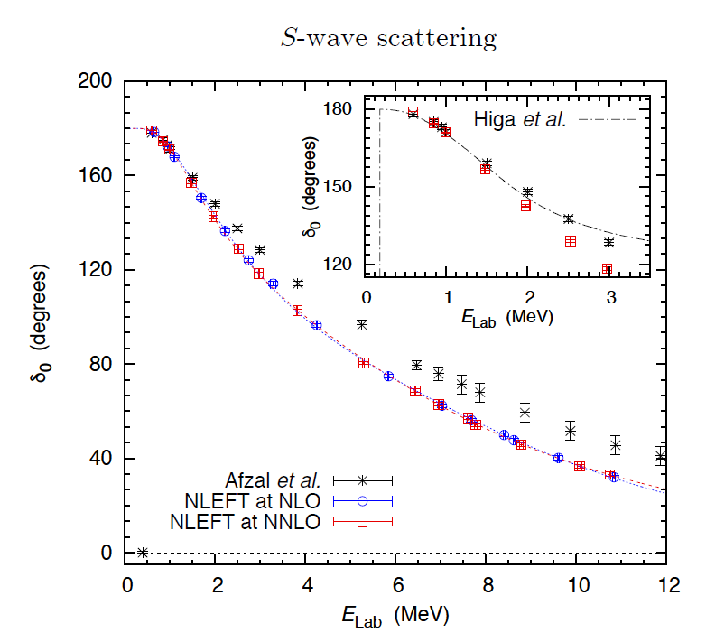
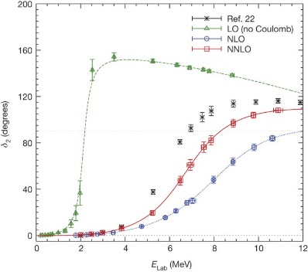
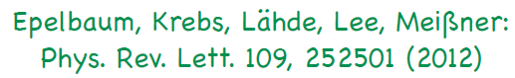
2. Nuclear Lattice Effective Field Theory
Applications of NLEFT
Nuclear matter, Cold atom, dilute fermion system
Finite nuclei
First ab-initio calculation of Hoyle state
Cluster structure of ¹²C and ¹⁶O
NN scattering, N-D scattering
Alpha-alpha scattering
radiative capture, fusion
Etc.
Ab initio alpha-alpha scattering
( Nature 528, 111-114(2015))

Slide 9
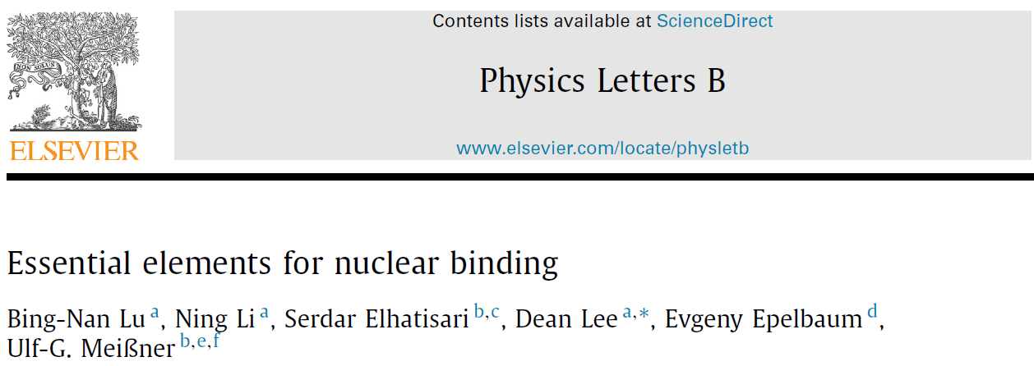
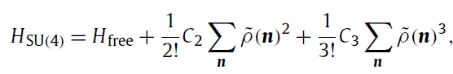
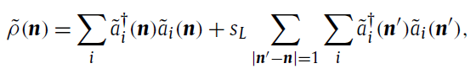
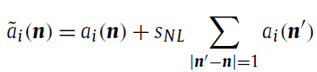
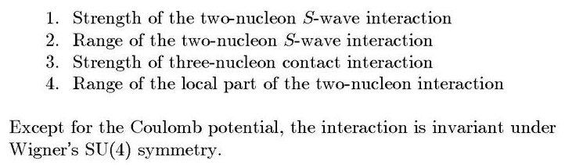
3. Wave Function Matching Method
Minimal nuclear interaction
Which reproduce
Light nuclei
medium mass nuclei
neutron matter
simultaneously up to few percent error in binding energy and charge radius
Only Four parameters
No sign problem

Slide 10
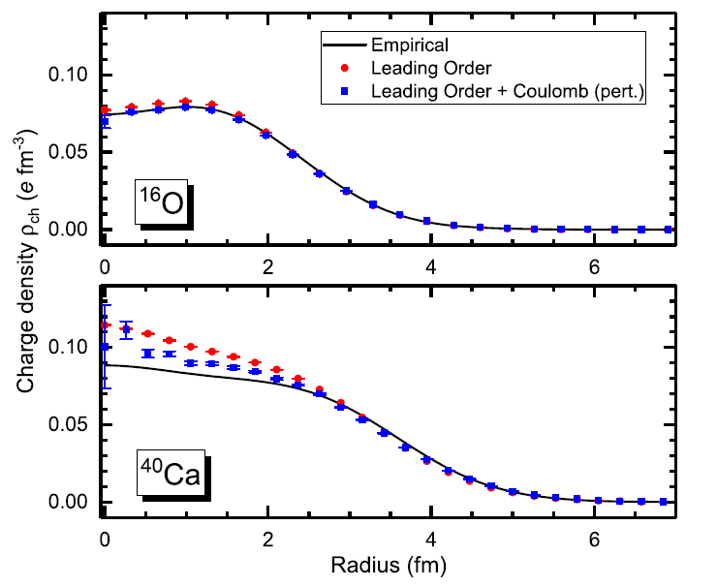
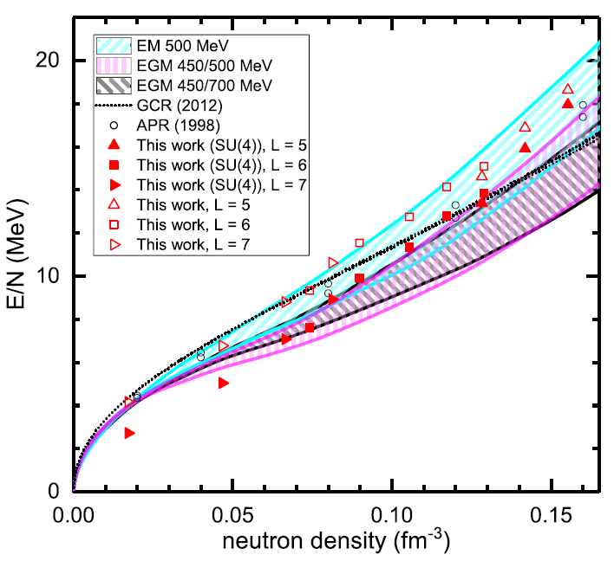
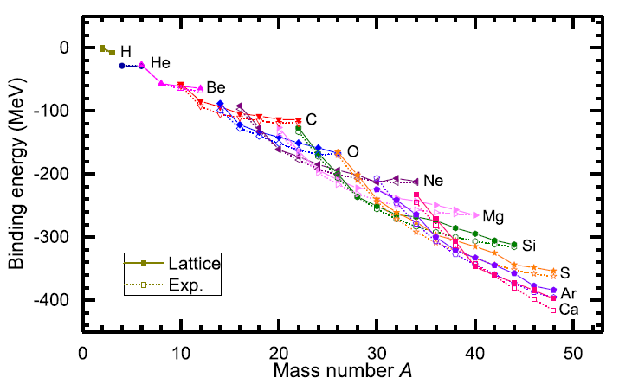
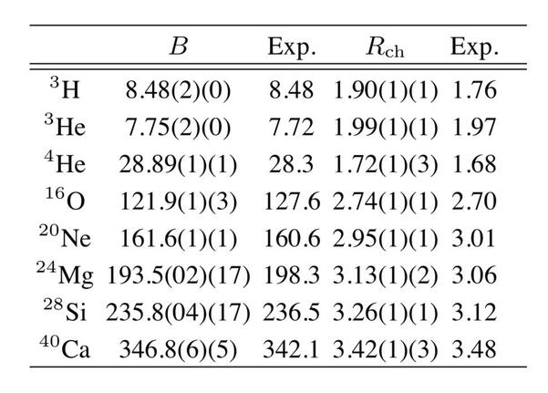
3. Wave Function Matching Method
Leading Order Results
How can we improve the calculation?
How can we extend the theory to the dripline?

Slide 11
3. Wave Function Matching Method
Difficulty in higher order/asymmetric nuclei
Sign problem
NLEFT suffers sign problems at large Euclidean time limit
Large cancellation between positive and negative contributions→ large uncertainty.
SU(4) symmetric interaction does not have sign problem
One pion exchange and higher order chiral interaction
Difficulty with Asymmetric nuclei
Needs a remedy to extend to neutron rich isotopes.
A new approach to reduce the sign problem.
→ Wave function matching Hamiltonian.

Slide 12
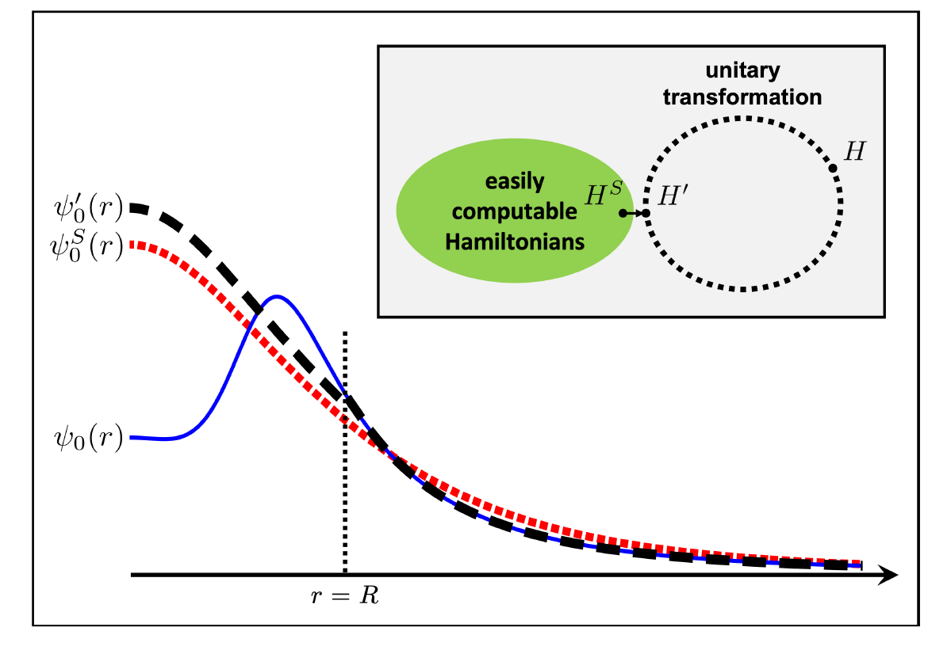
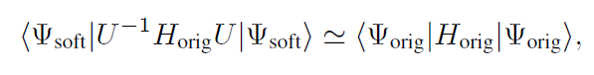
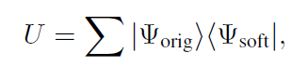
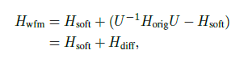
3. Wave Function Matching Method
H and H’ are fully equivalent to two-body observables
The goal is to make the perturbation expansion from “simple” wave function gives a good convergence
U is only active
At r < R

Slide 13
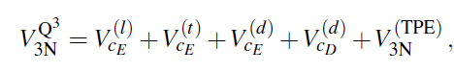
3. Wave Function Matching Method
N3LO Hamiltonian
V_2N : short range NN interactions (determined from NN scattering)
W_2N: GIR restoration term for V_2N
V_2N,WFM : difference from H_s
W_2N,WFM: GIR restoration correction to V_2N,WFM
V_3N : contains short range 3N interaction parameters(to be fitted)
and two pion exchange correction to 3N

Slide 14
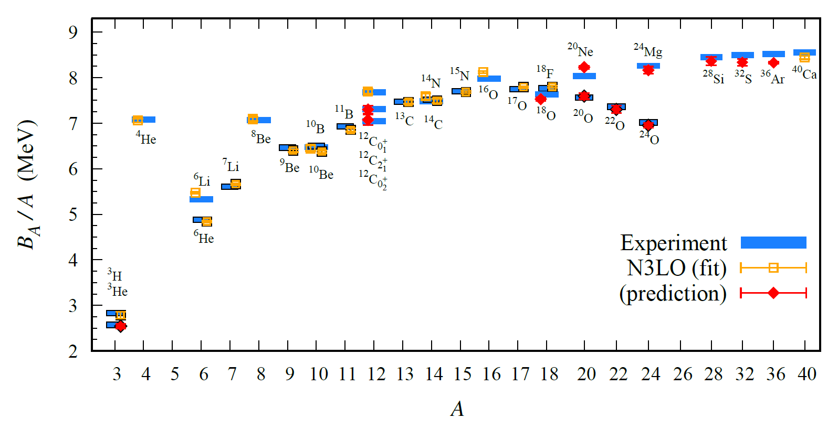
4. Results
BE/A

Slide 15
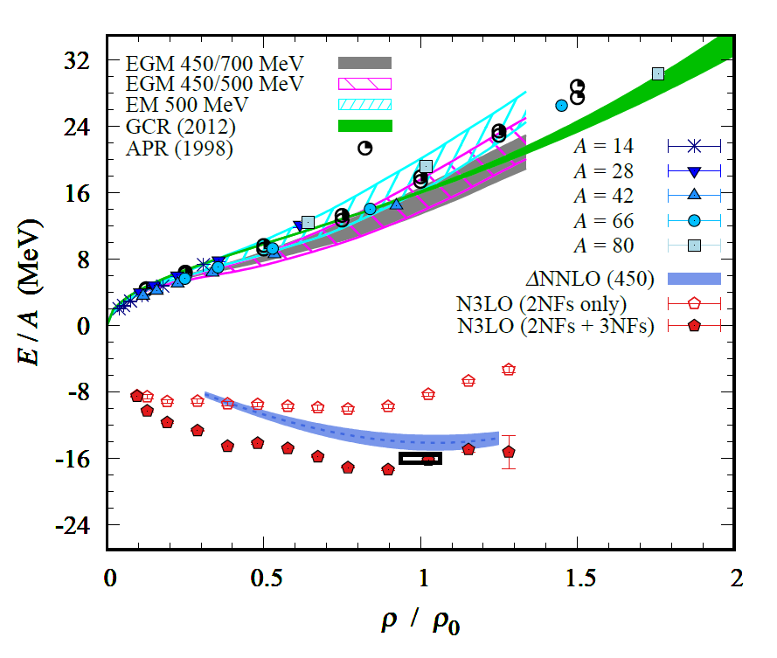
4. Results

Slide 16
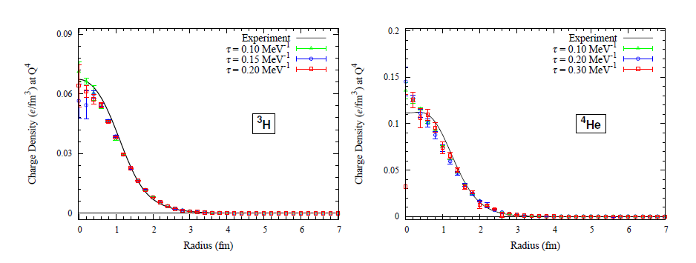
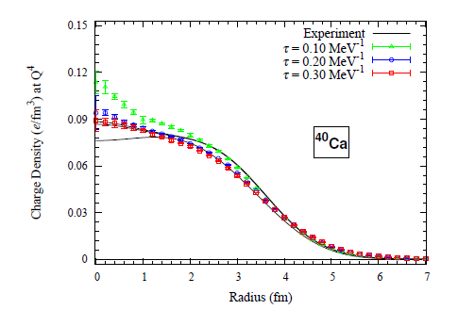
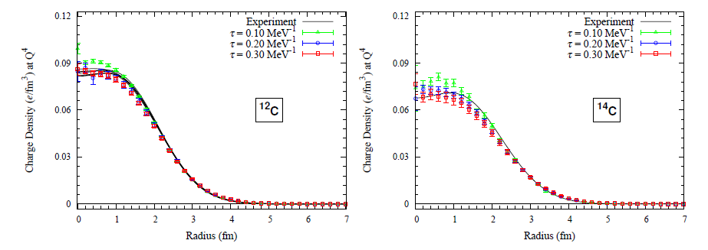
4. Results

Slide 17
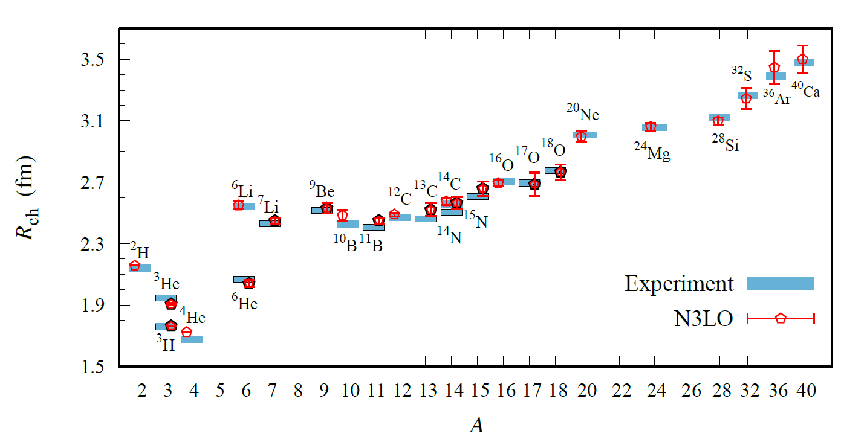
4. Results
Charge Radius
Submitted to Nature

Slide 18
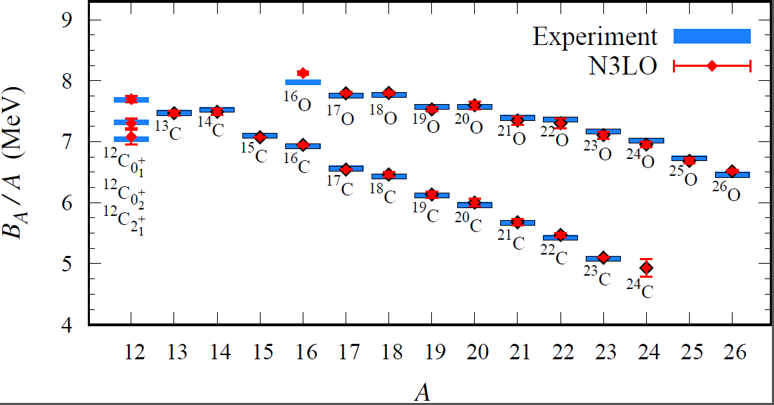
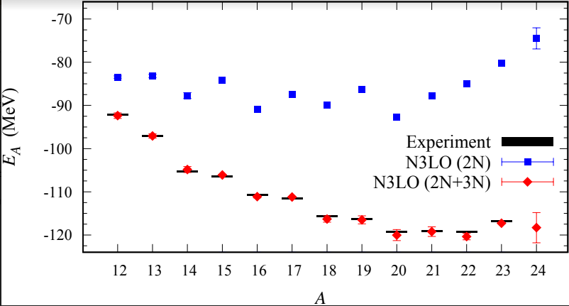
4. Results
Dripline of Carbon and Oxygen Isotopes

Slide 19
4. Works in Progress
Full chiral EFT calculation are very expensive for many fermions.
Unitary Fermion Gas :
A strongly coupled conformal system
Physically interesting multi-fermion system with simple interaction
Unitary Fermion itself does not form a bound nuclei
→ Introduce an external spherical well potential
Can we find a relation between spherical well shape and dripline?
Separation energy have to be calculated accurately
→ Use an re-weighting method to reduce error in separation energy.
( Use the same weighting for A-body and (A-n) body system
→ correlated error estimation in energy difference.)
Unfortunately, realistic mean-field potential is rather expensive.
(reaching dripline in Unitary limits is difficult.)
→ limited to shallow external potential.
Try to see the dependence on parameter : y0 = m R^2 V
(Work in progress. Only preliminary results)

Slide 20
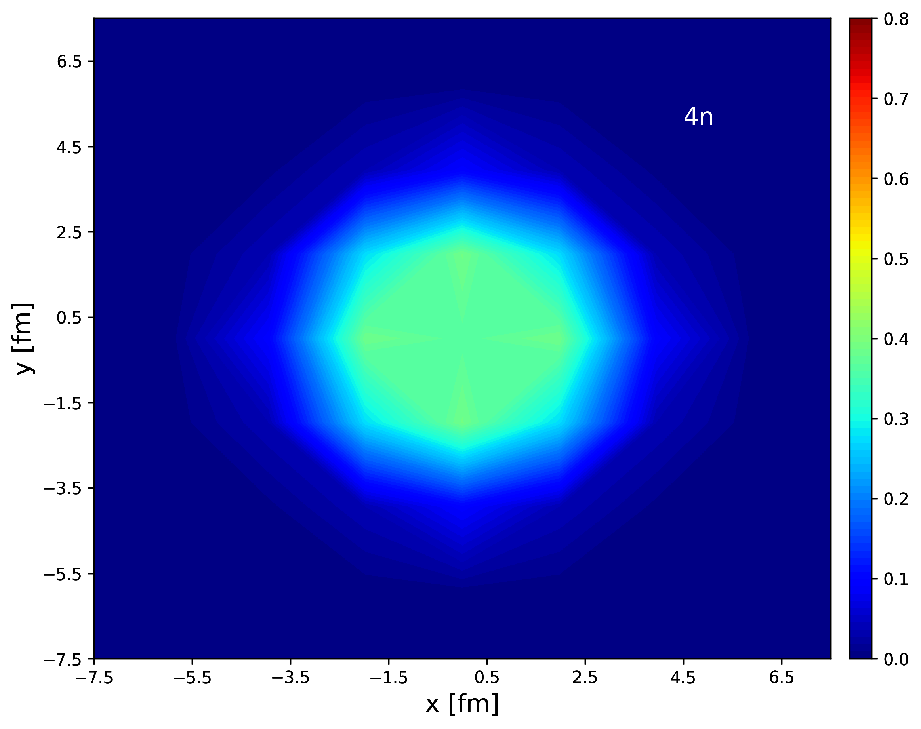
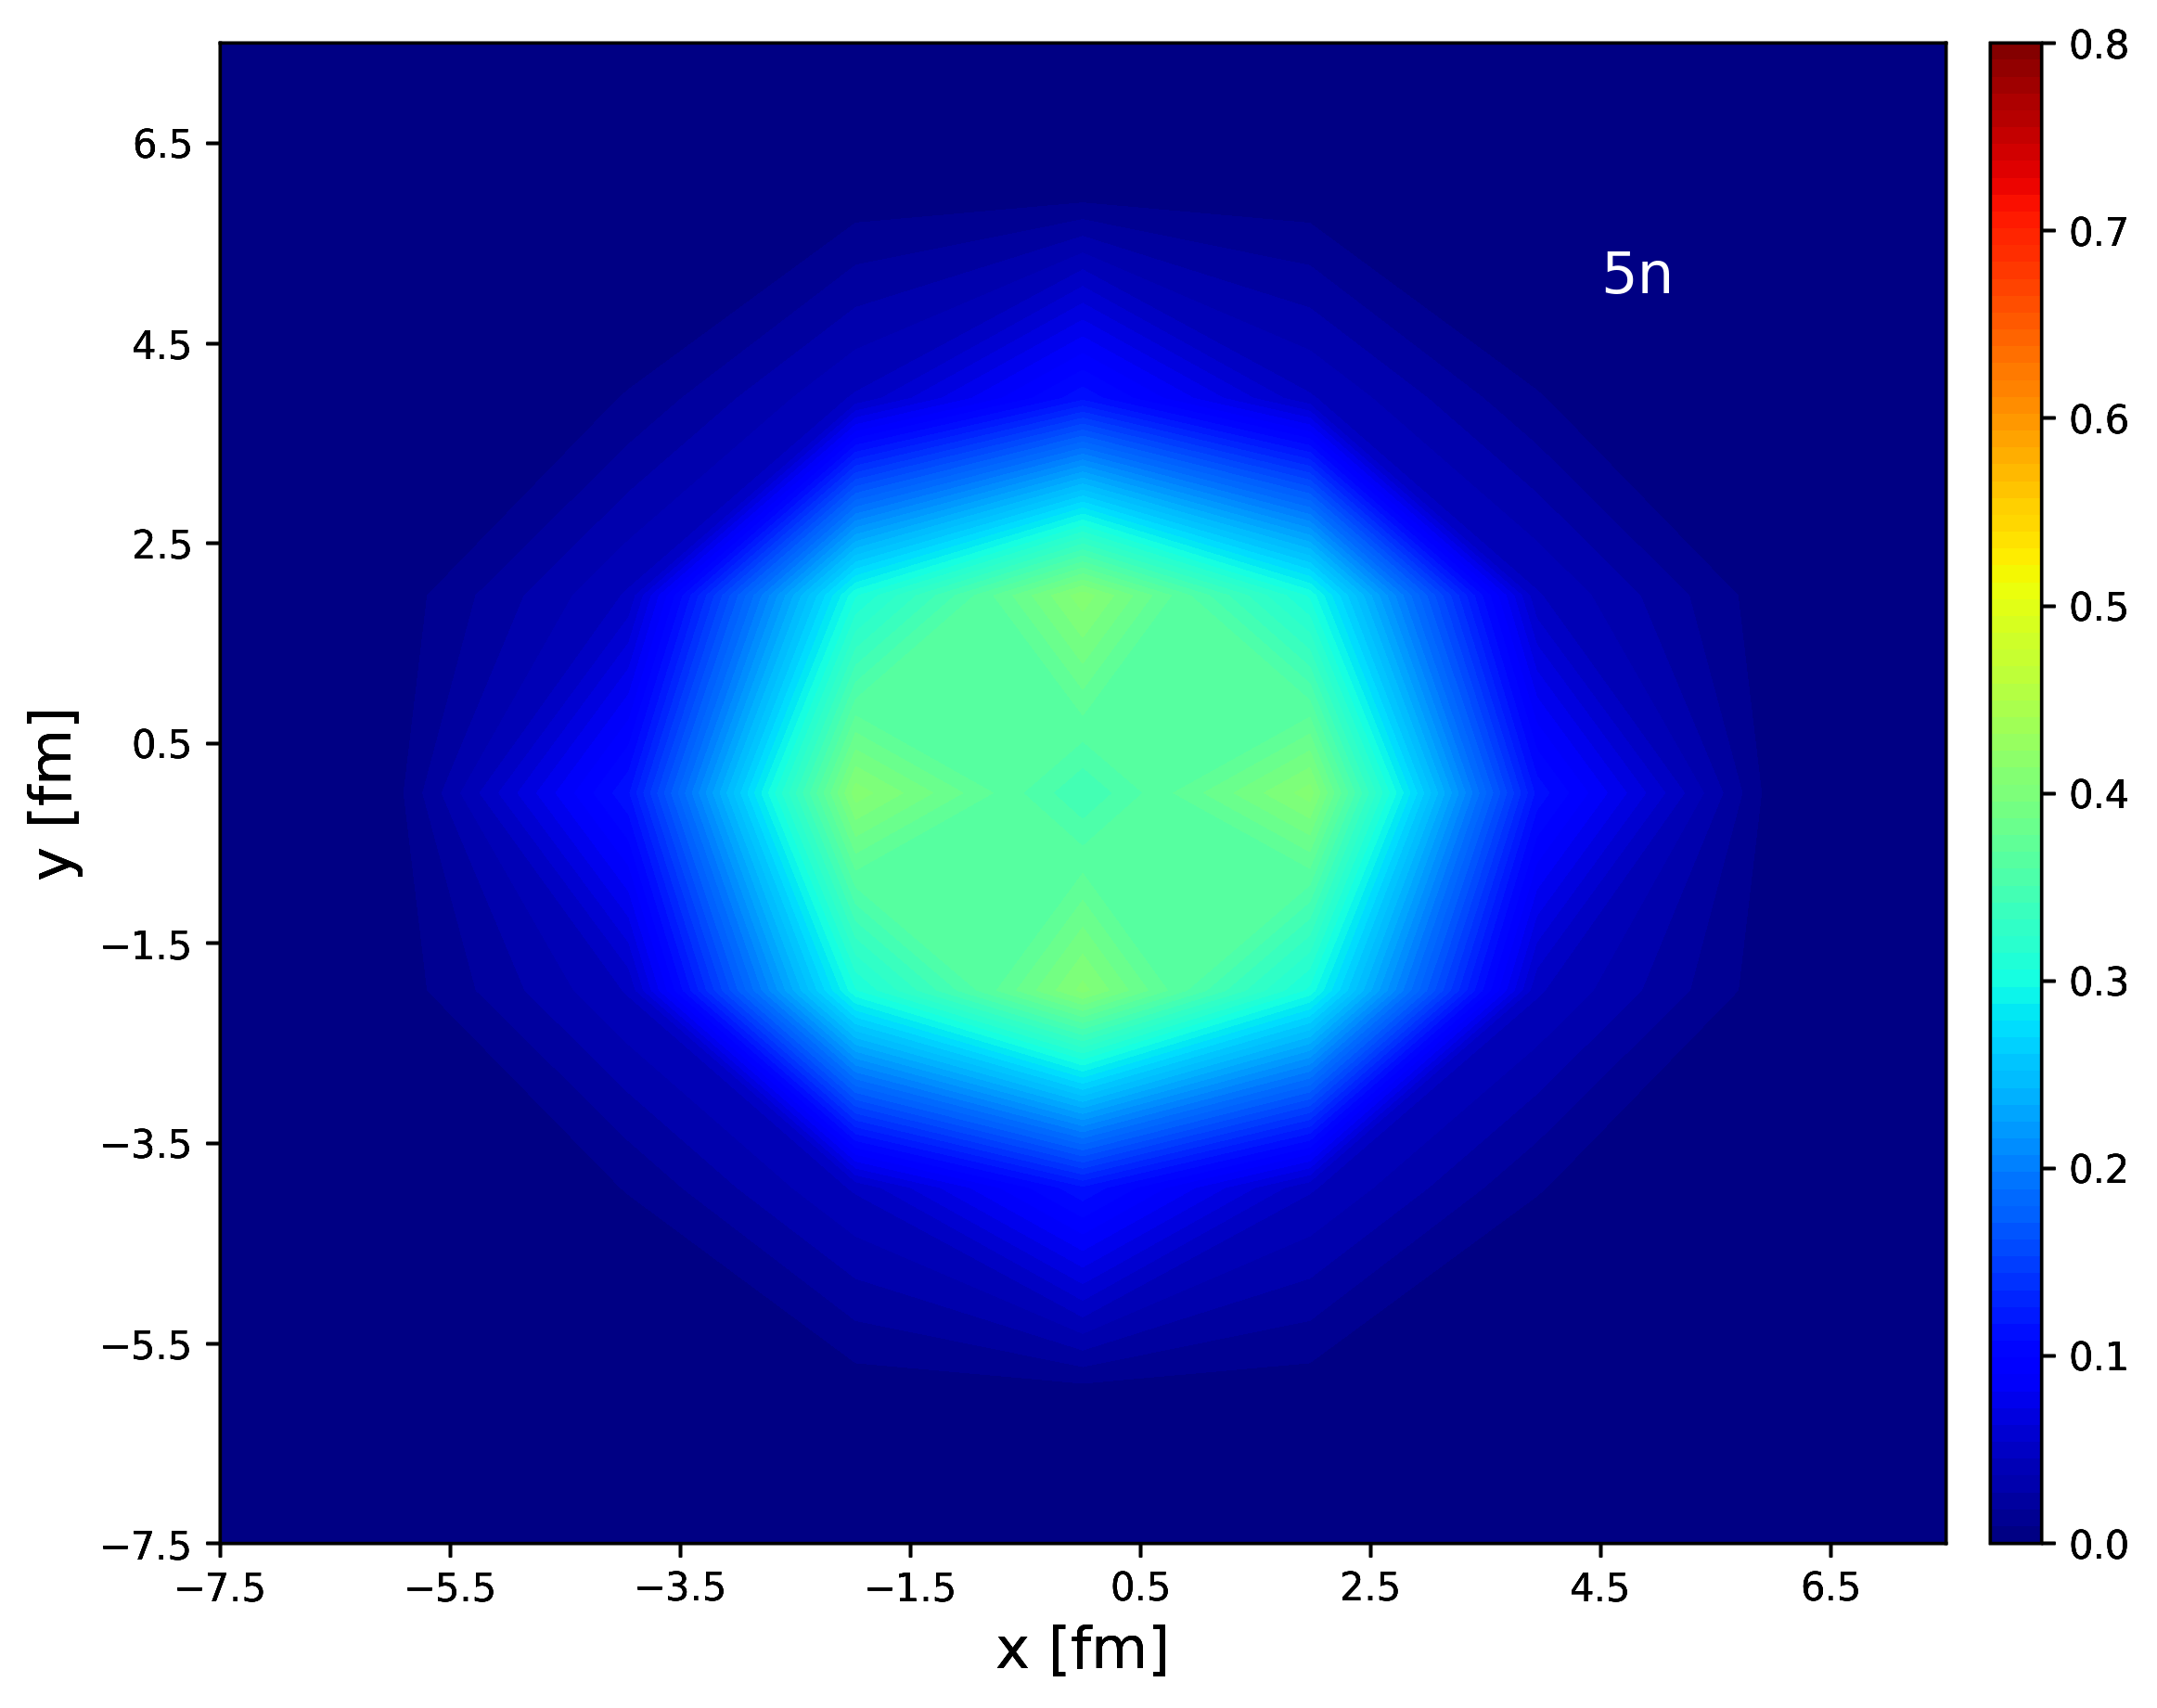
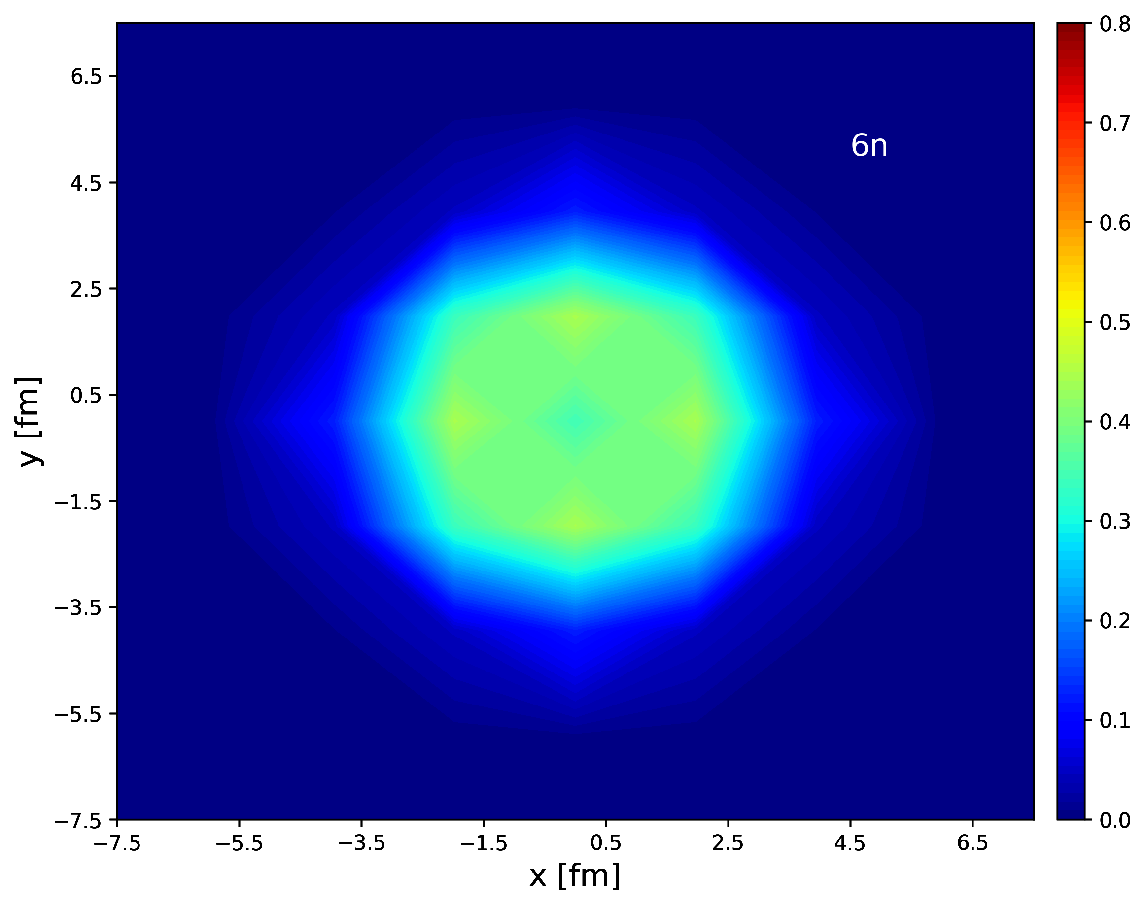
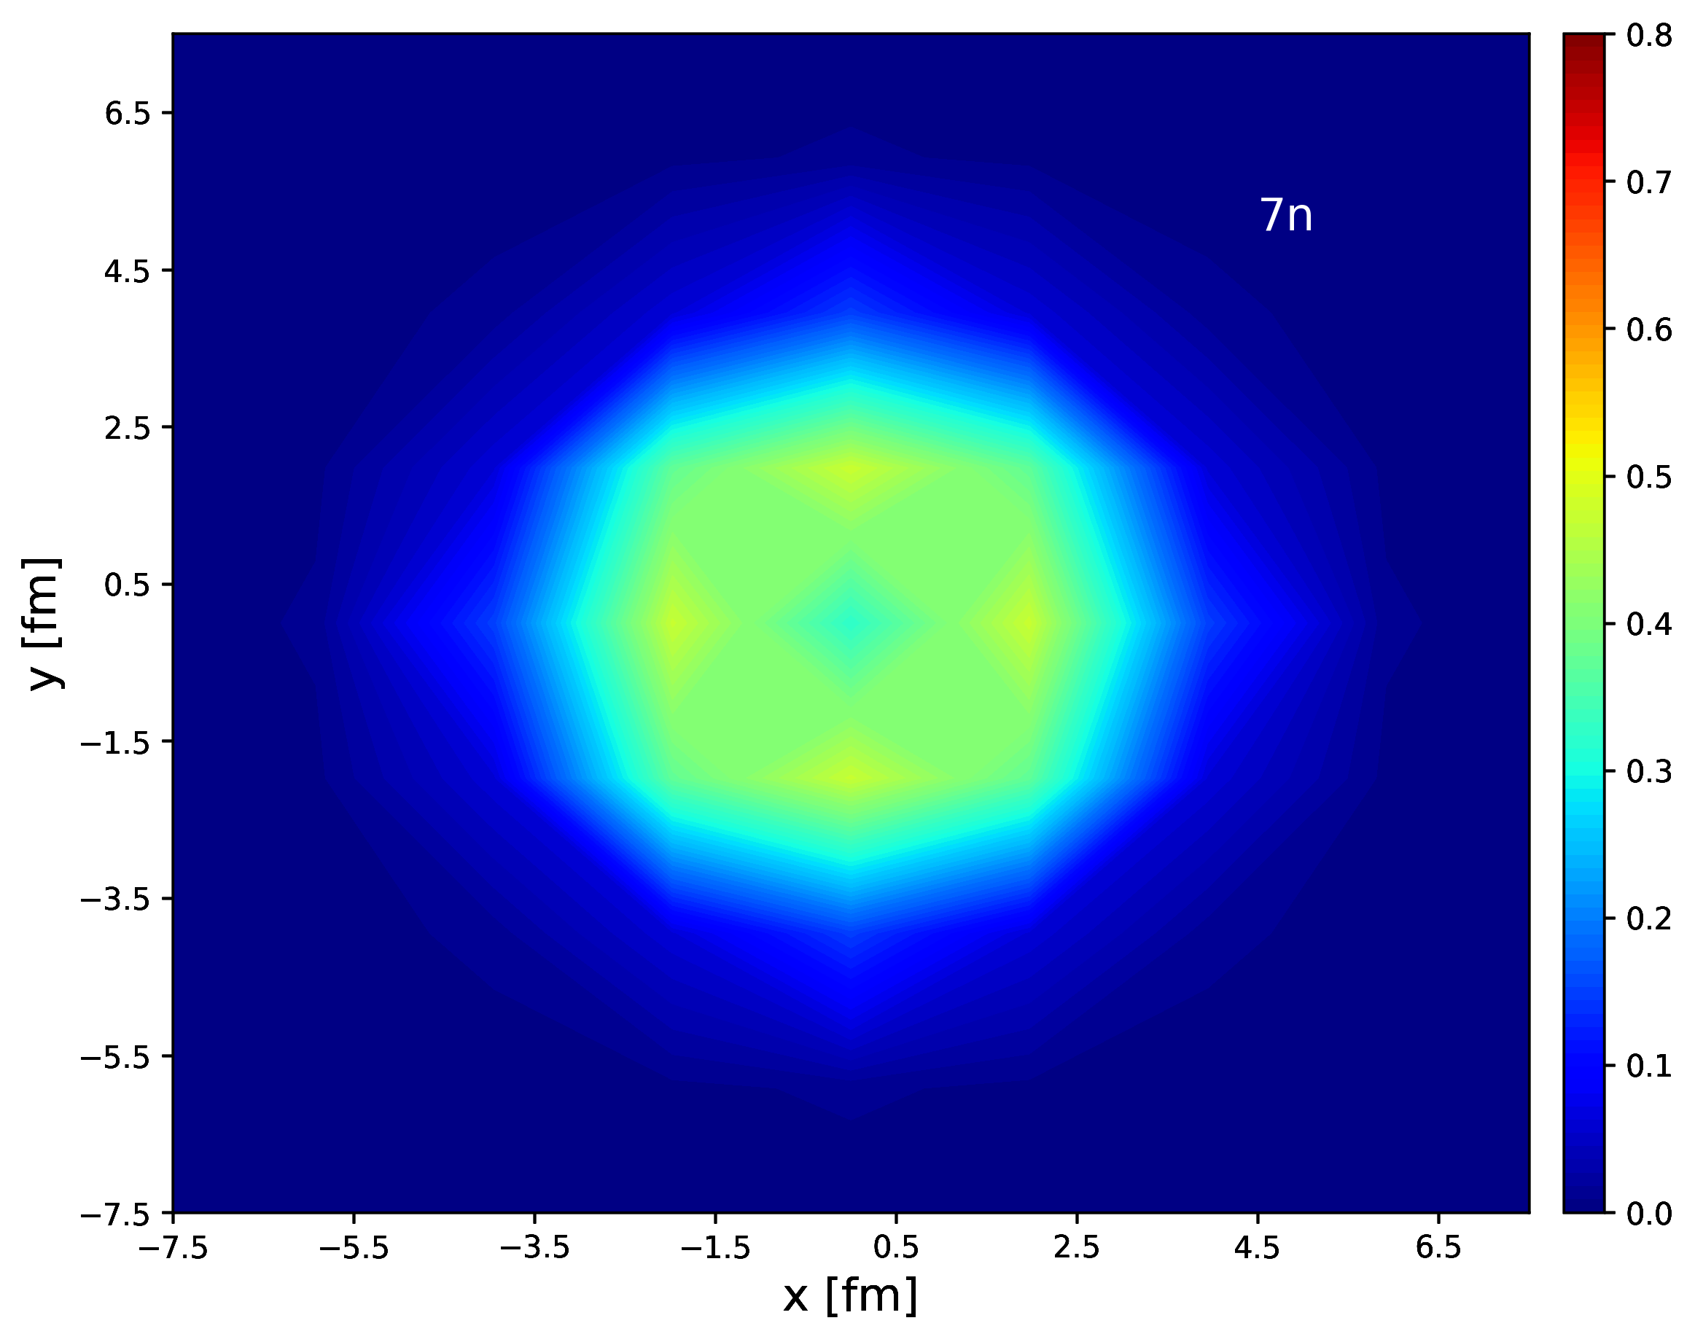
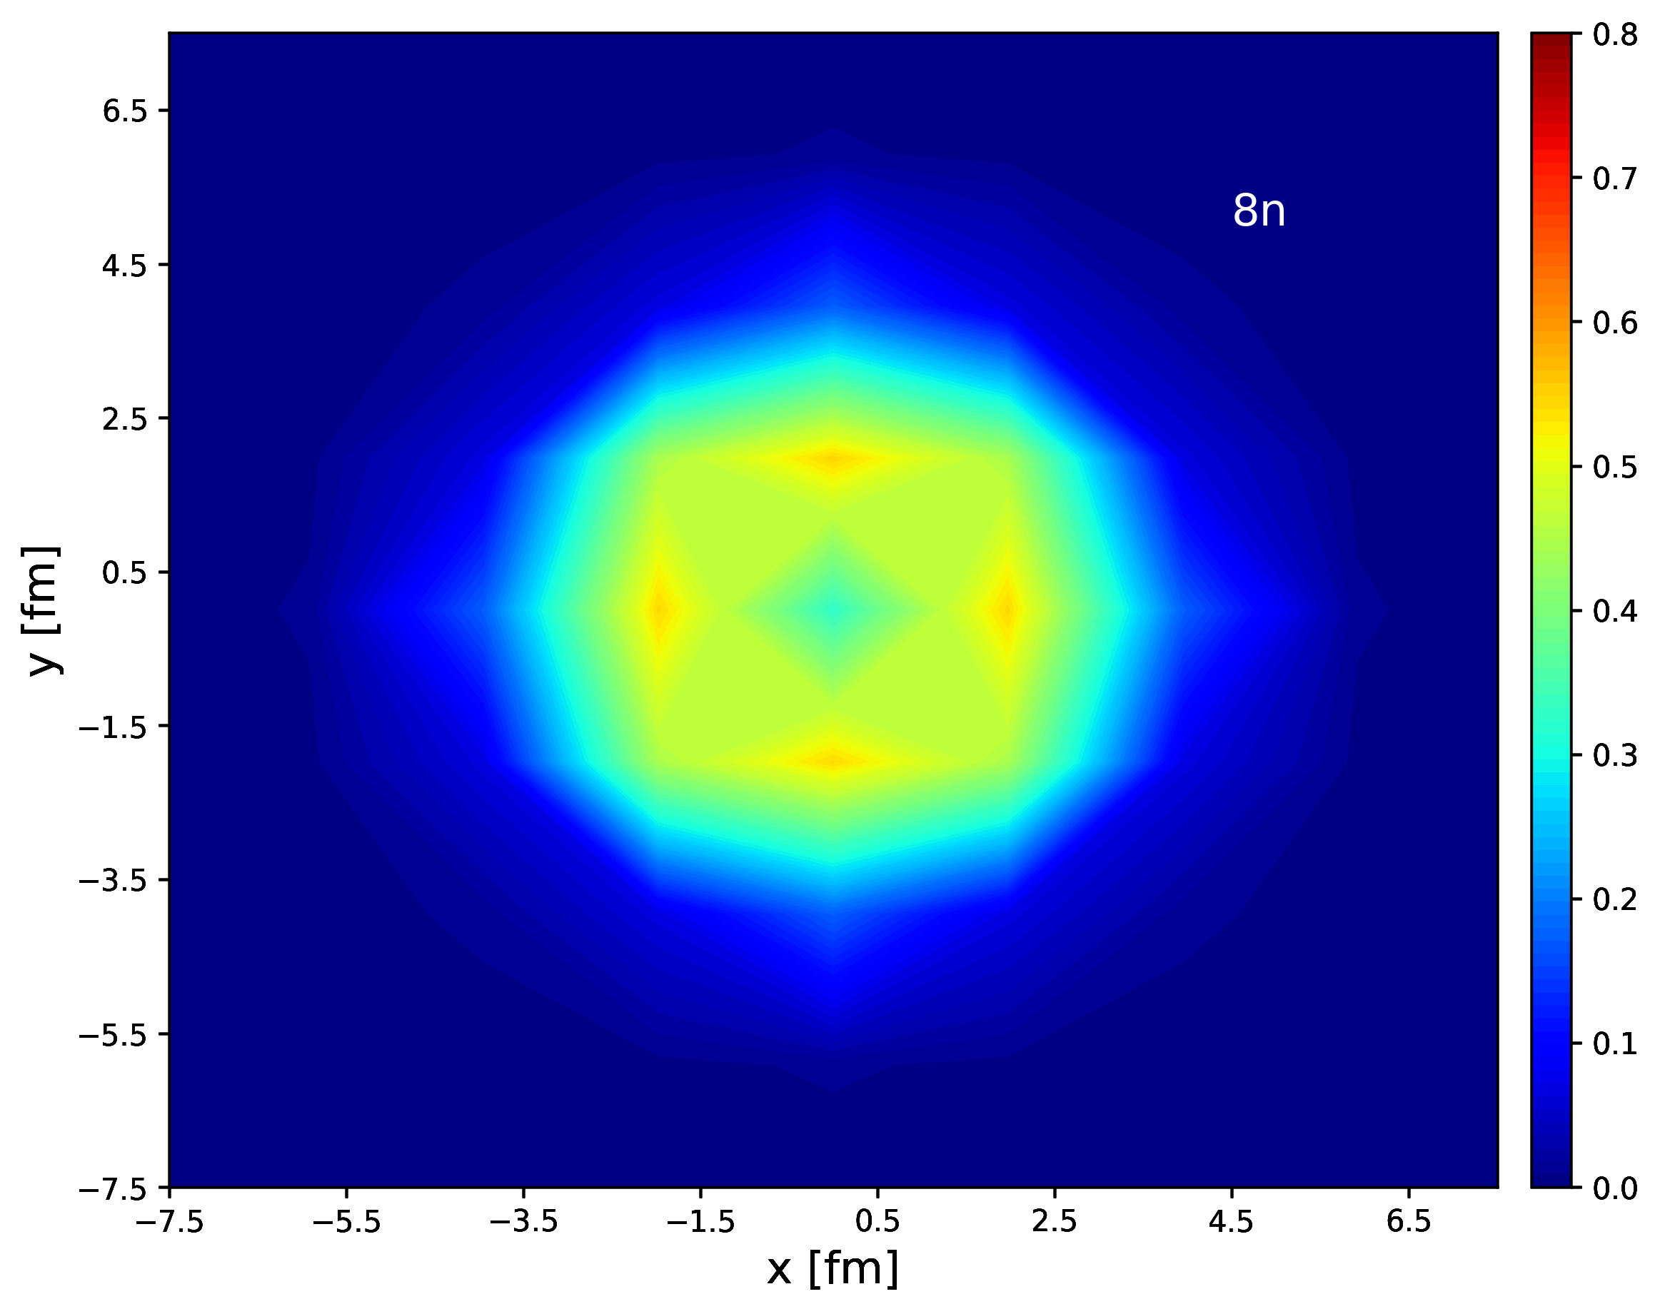
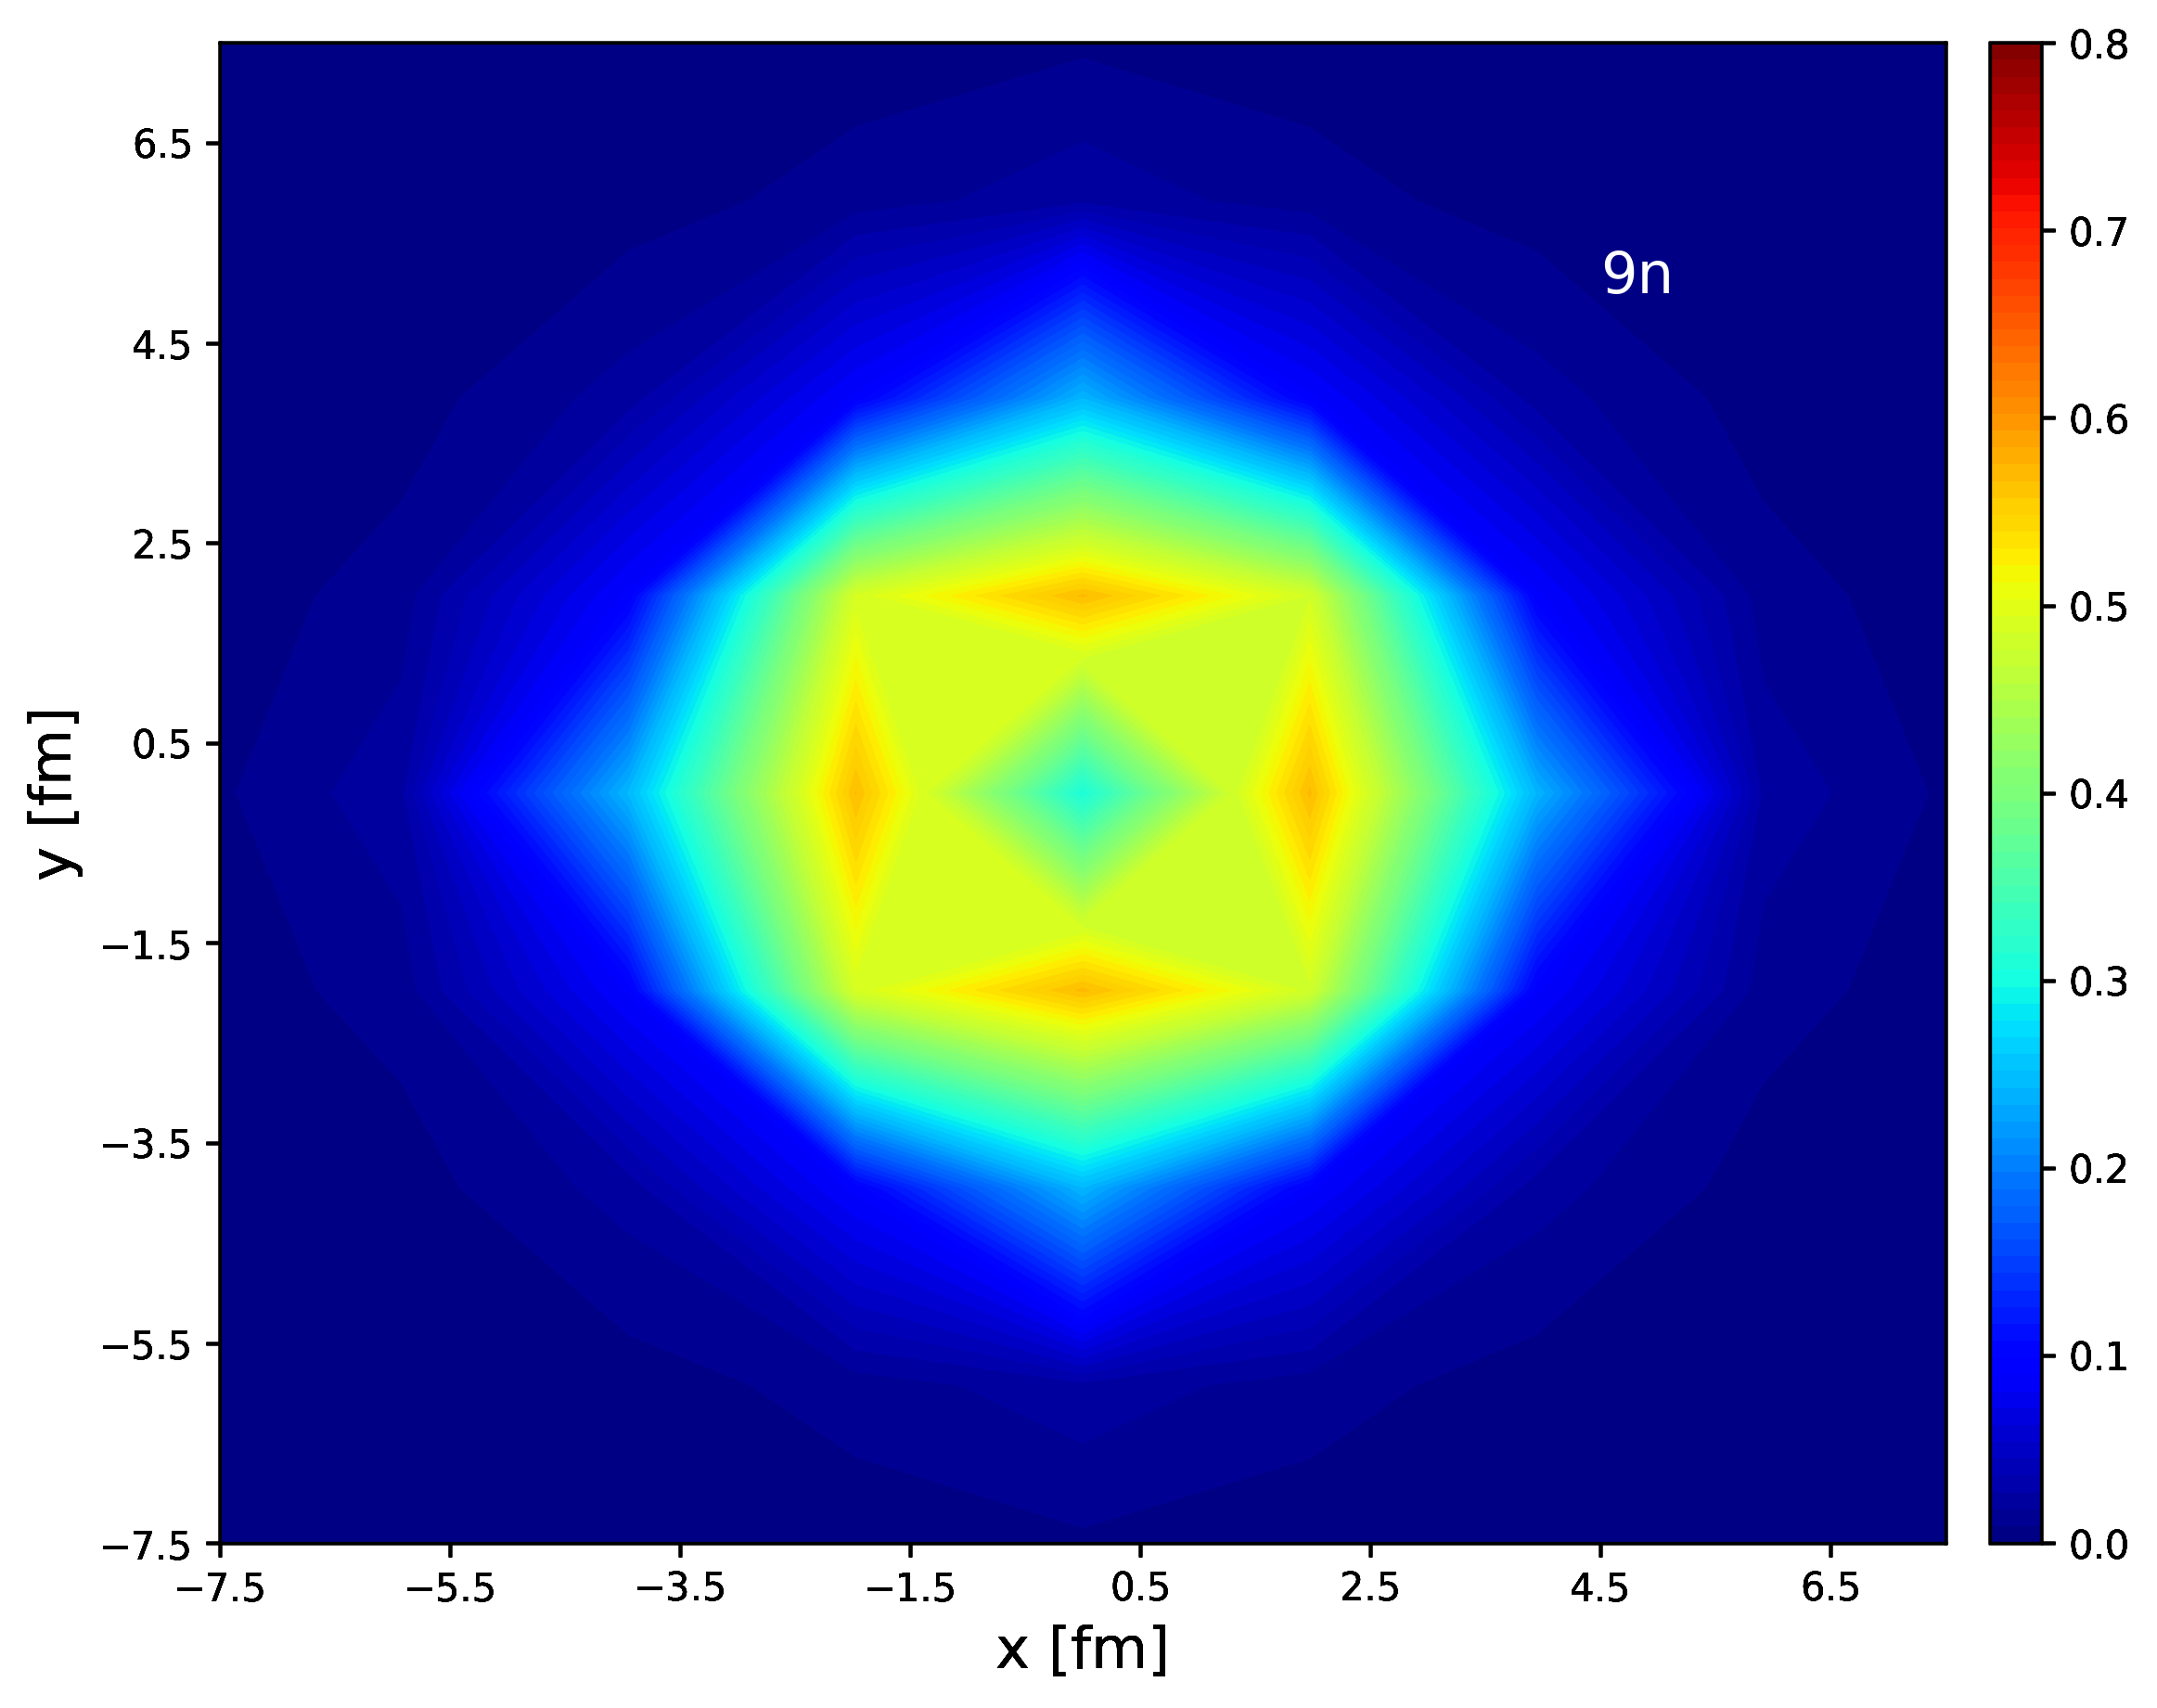
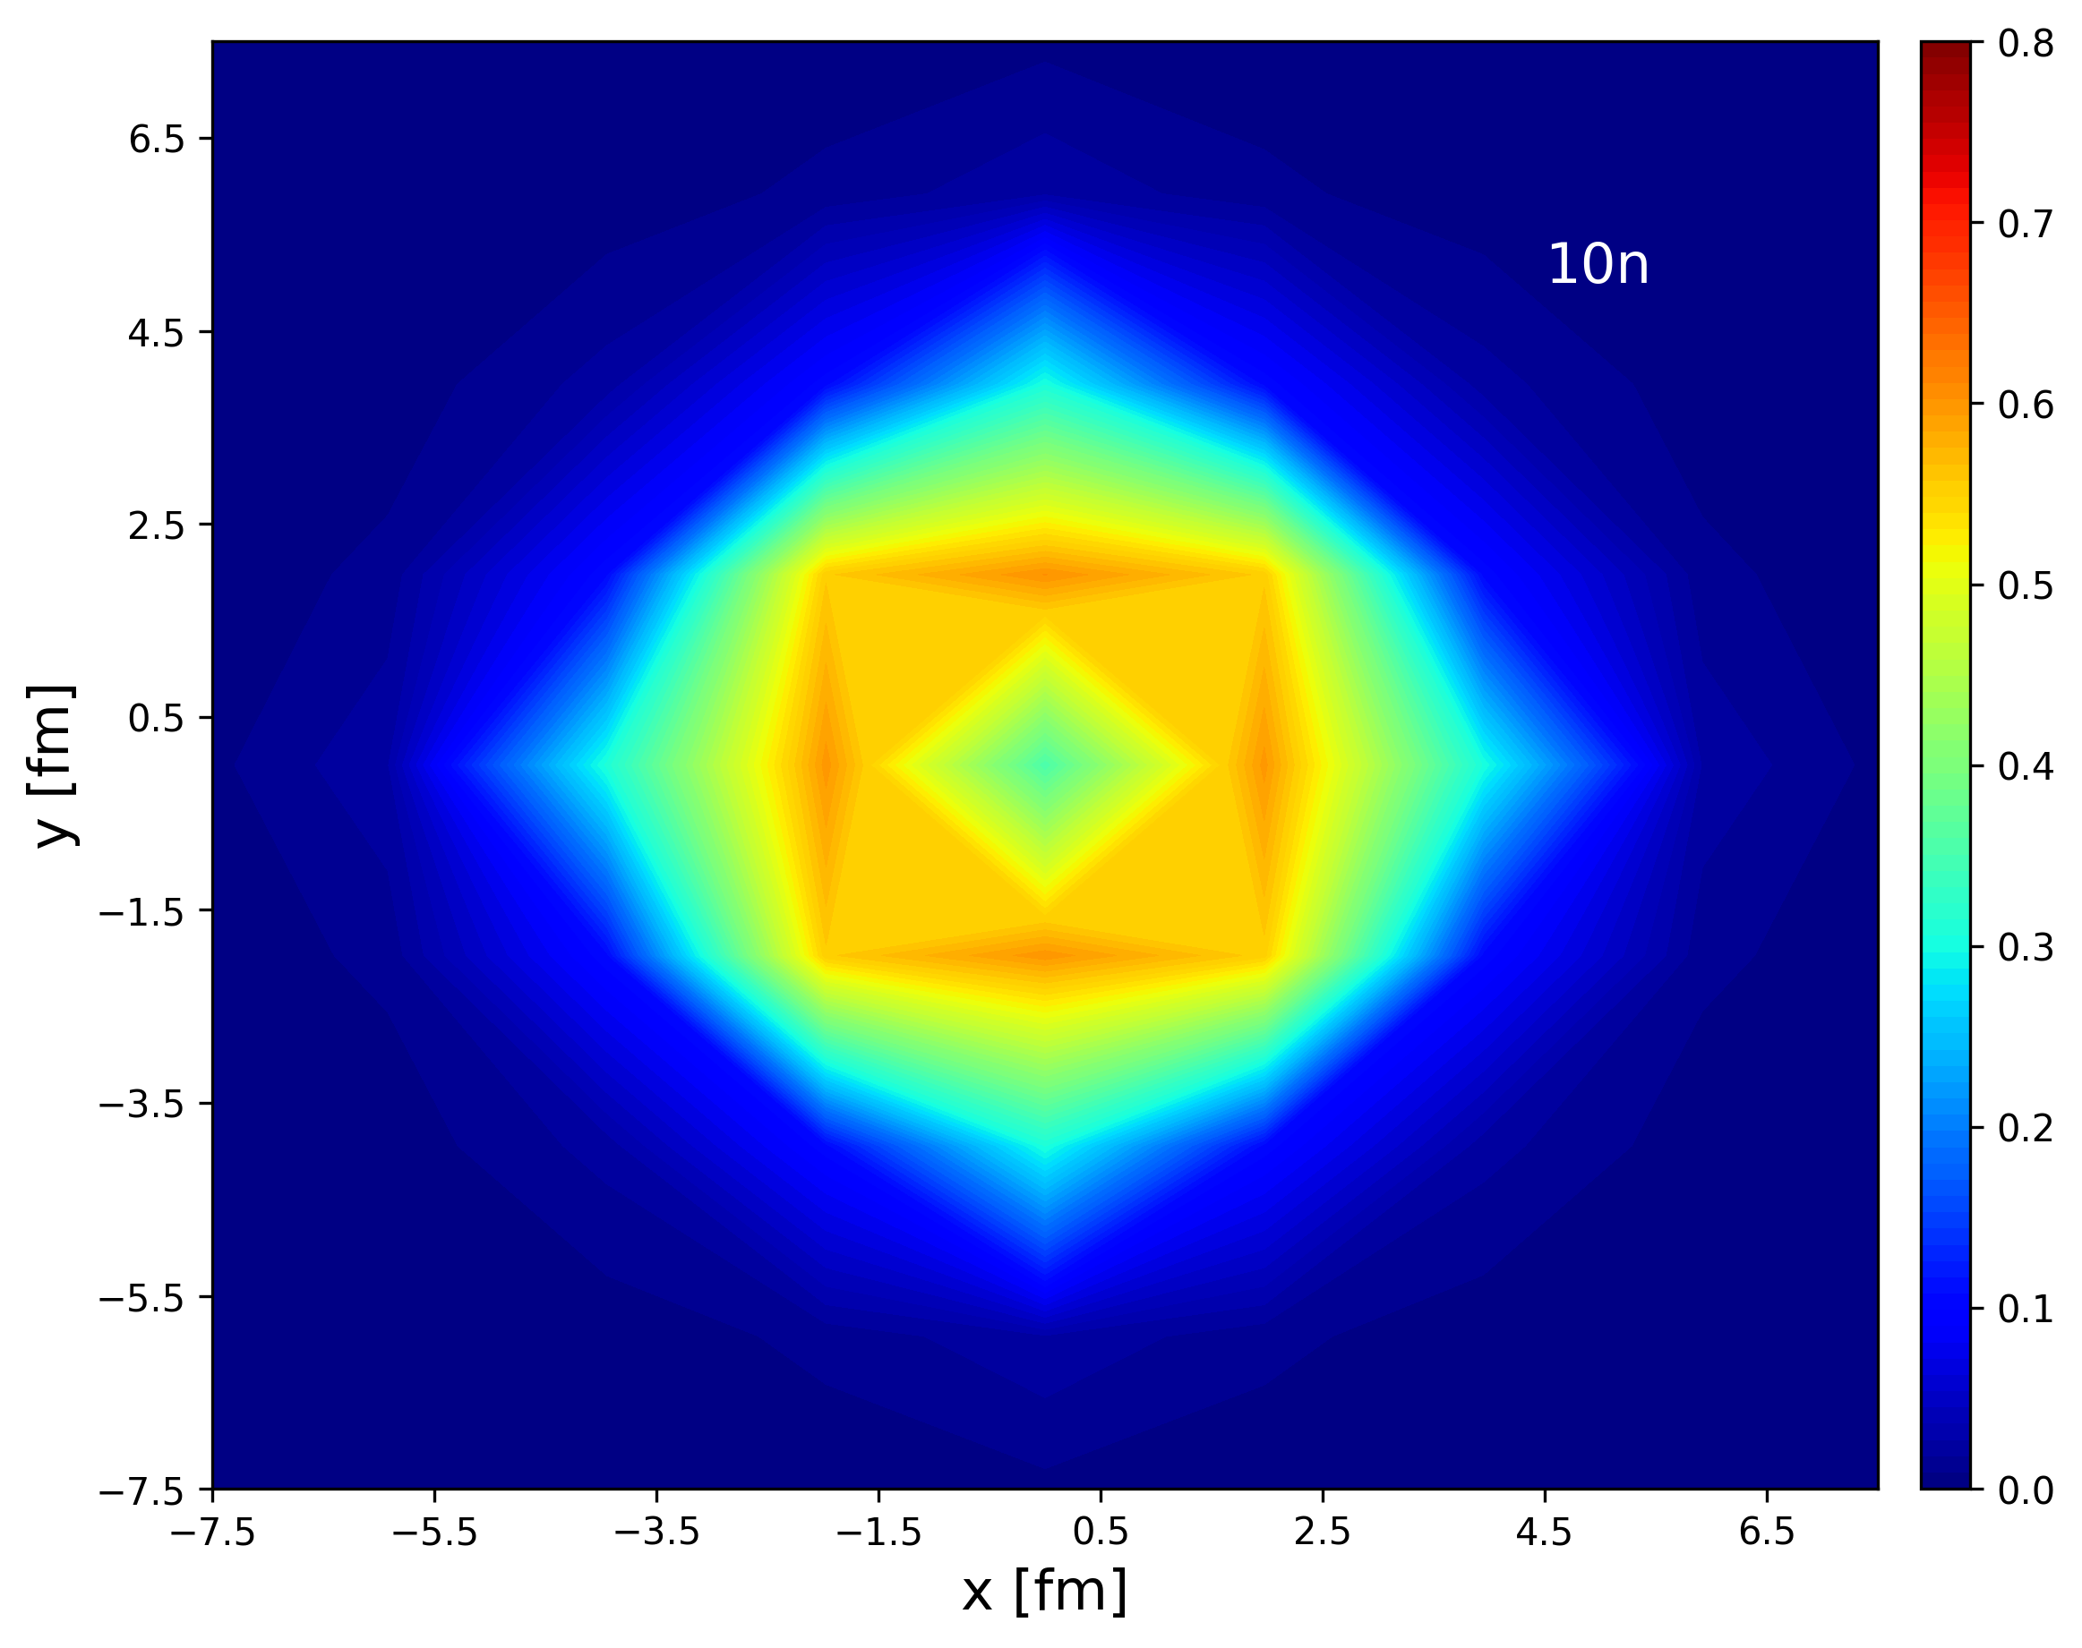

4. Works in Progress

Slide 21
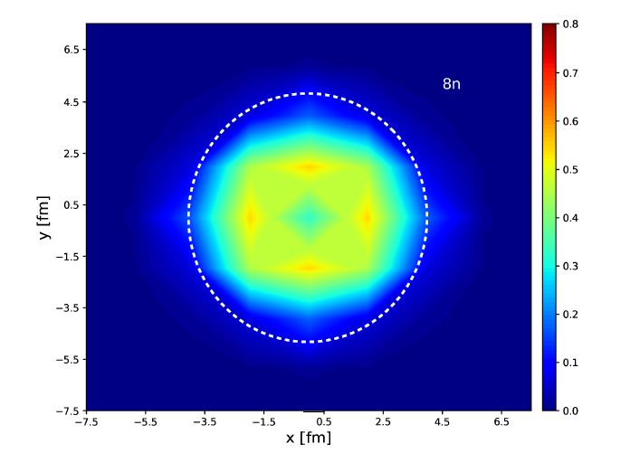
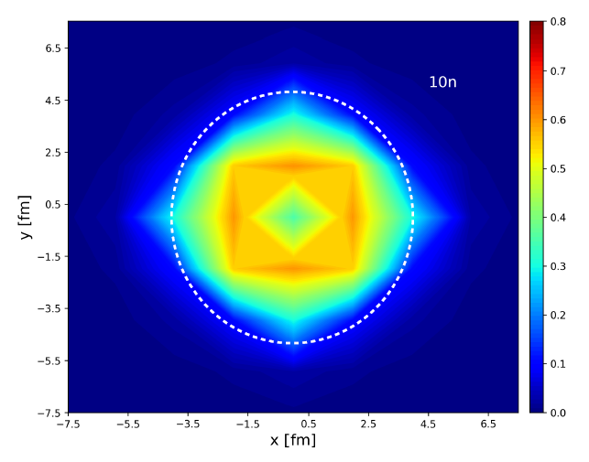
4. Works in Progress

Slide 22
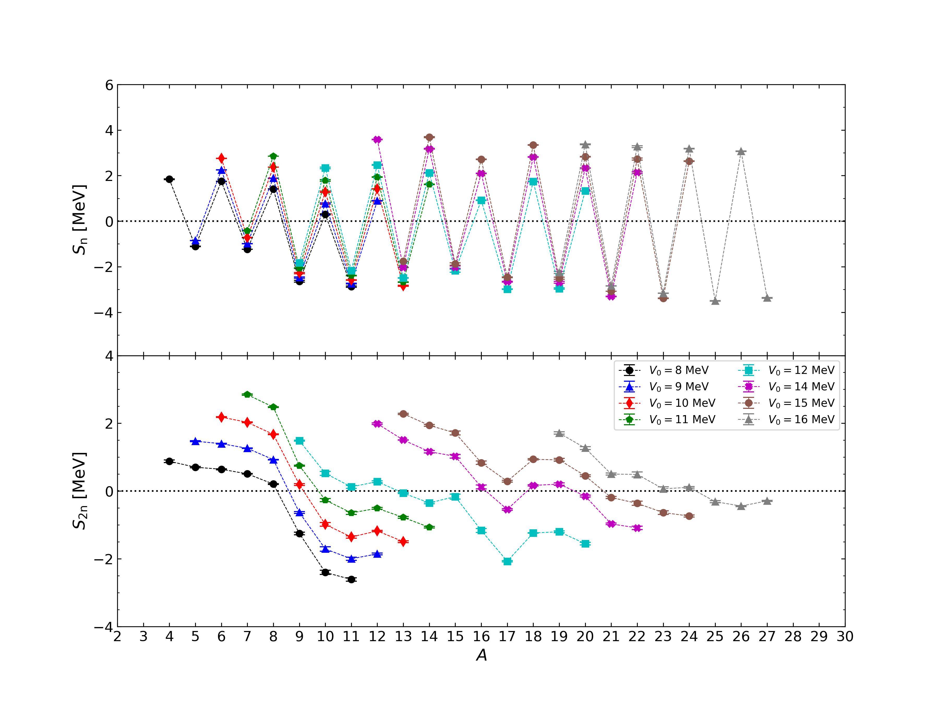
4. Works in Progress
Preliminary

Slide 23
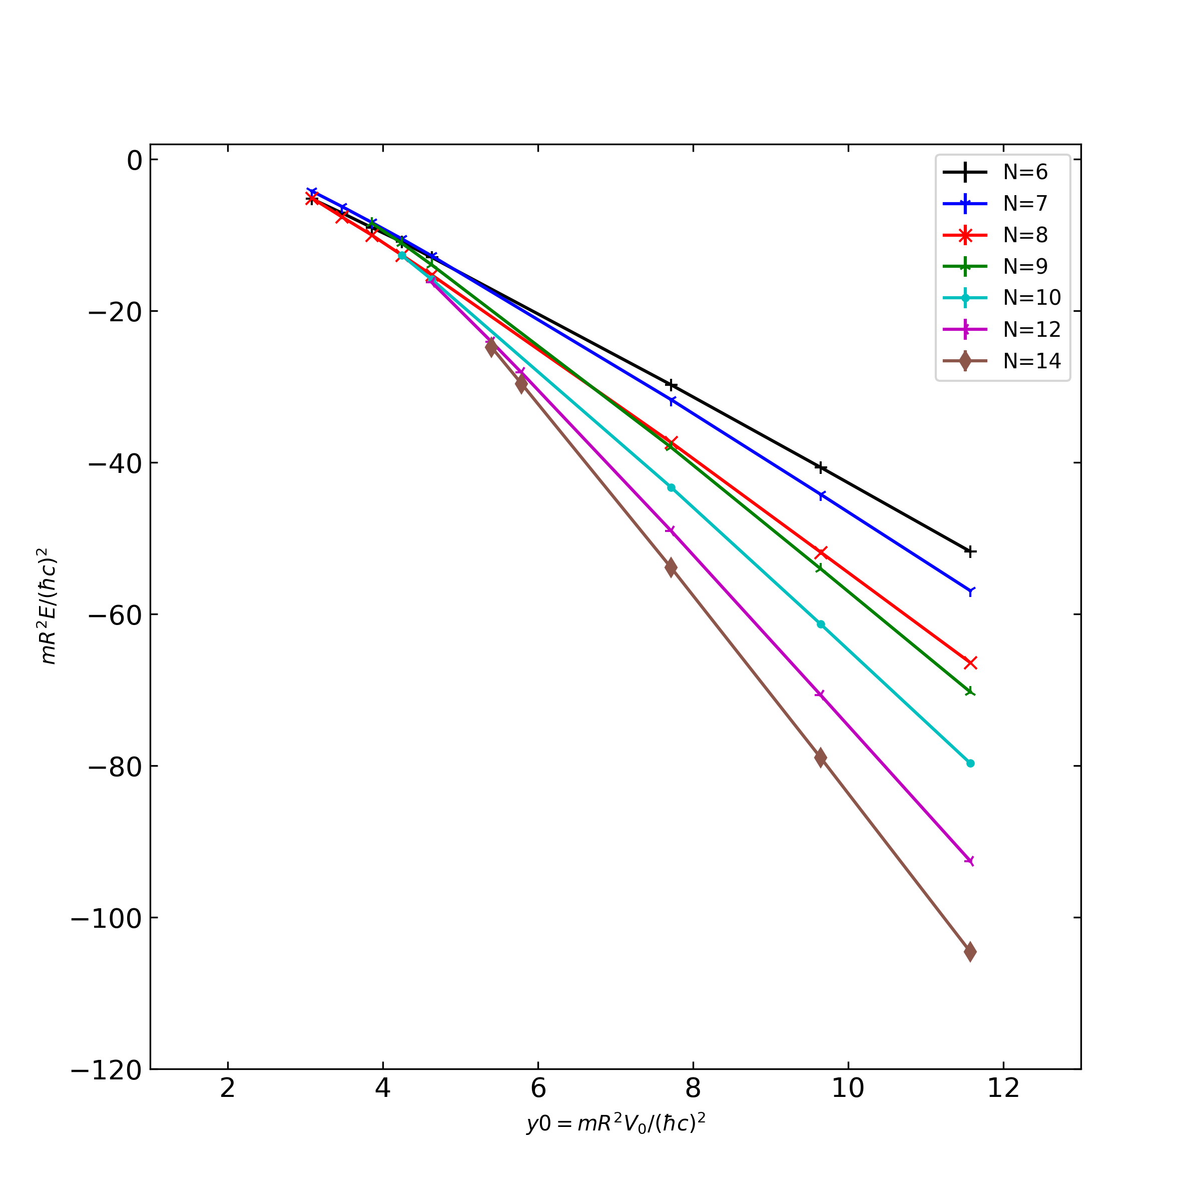
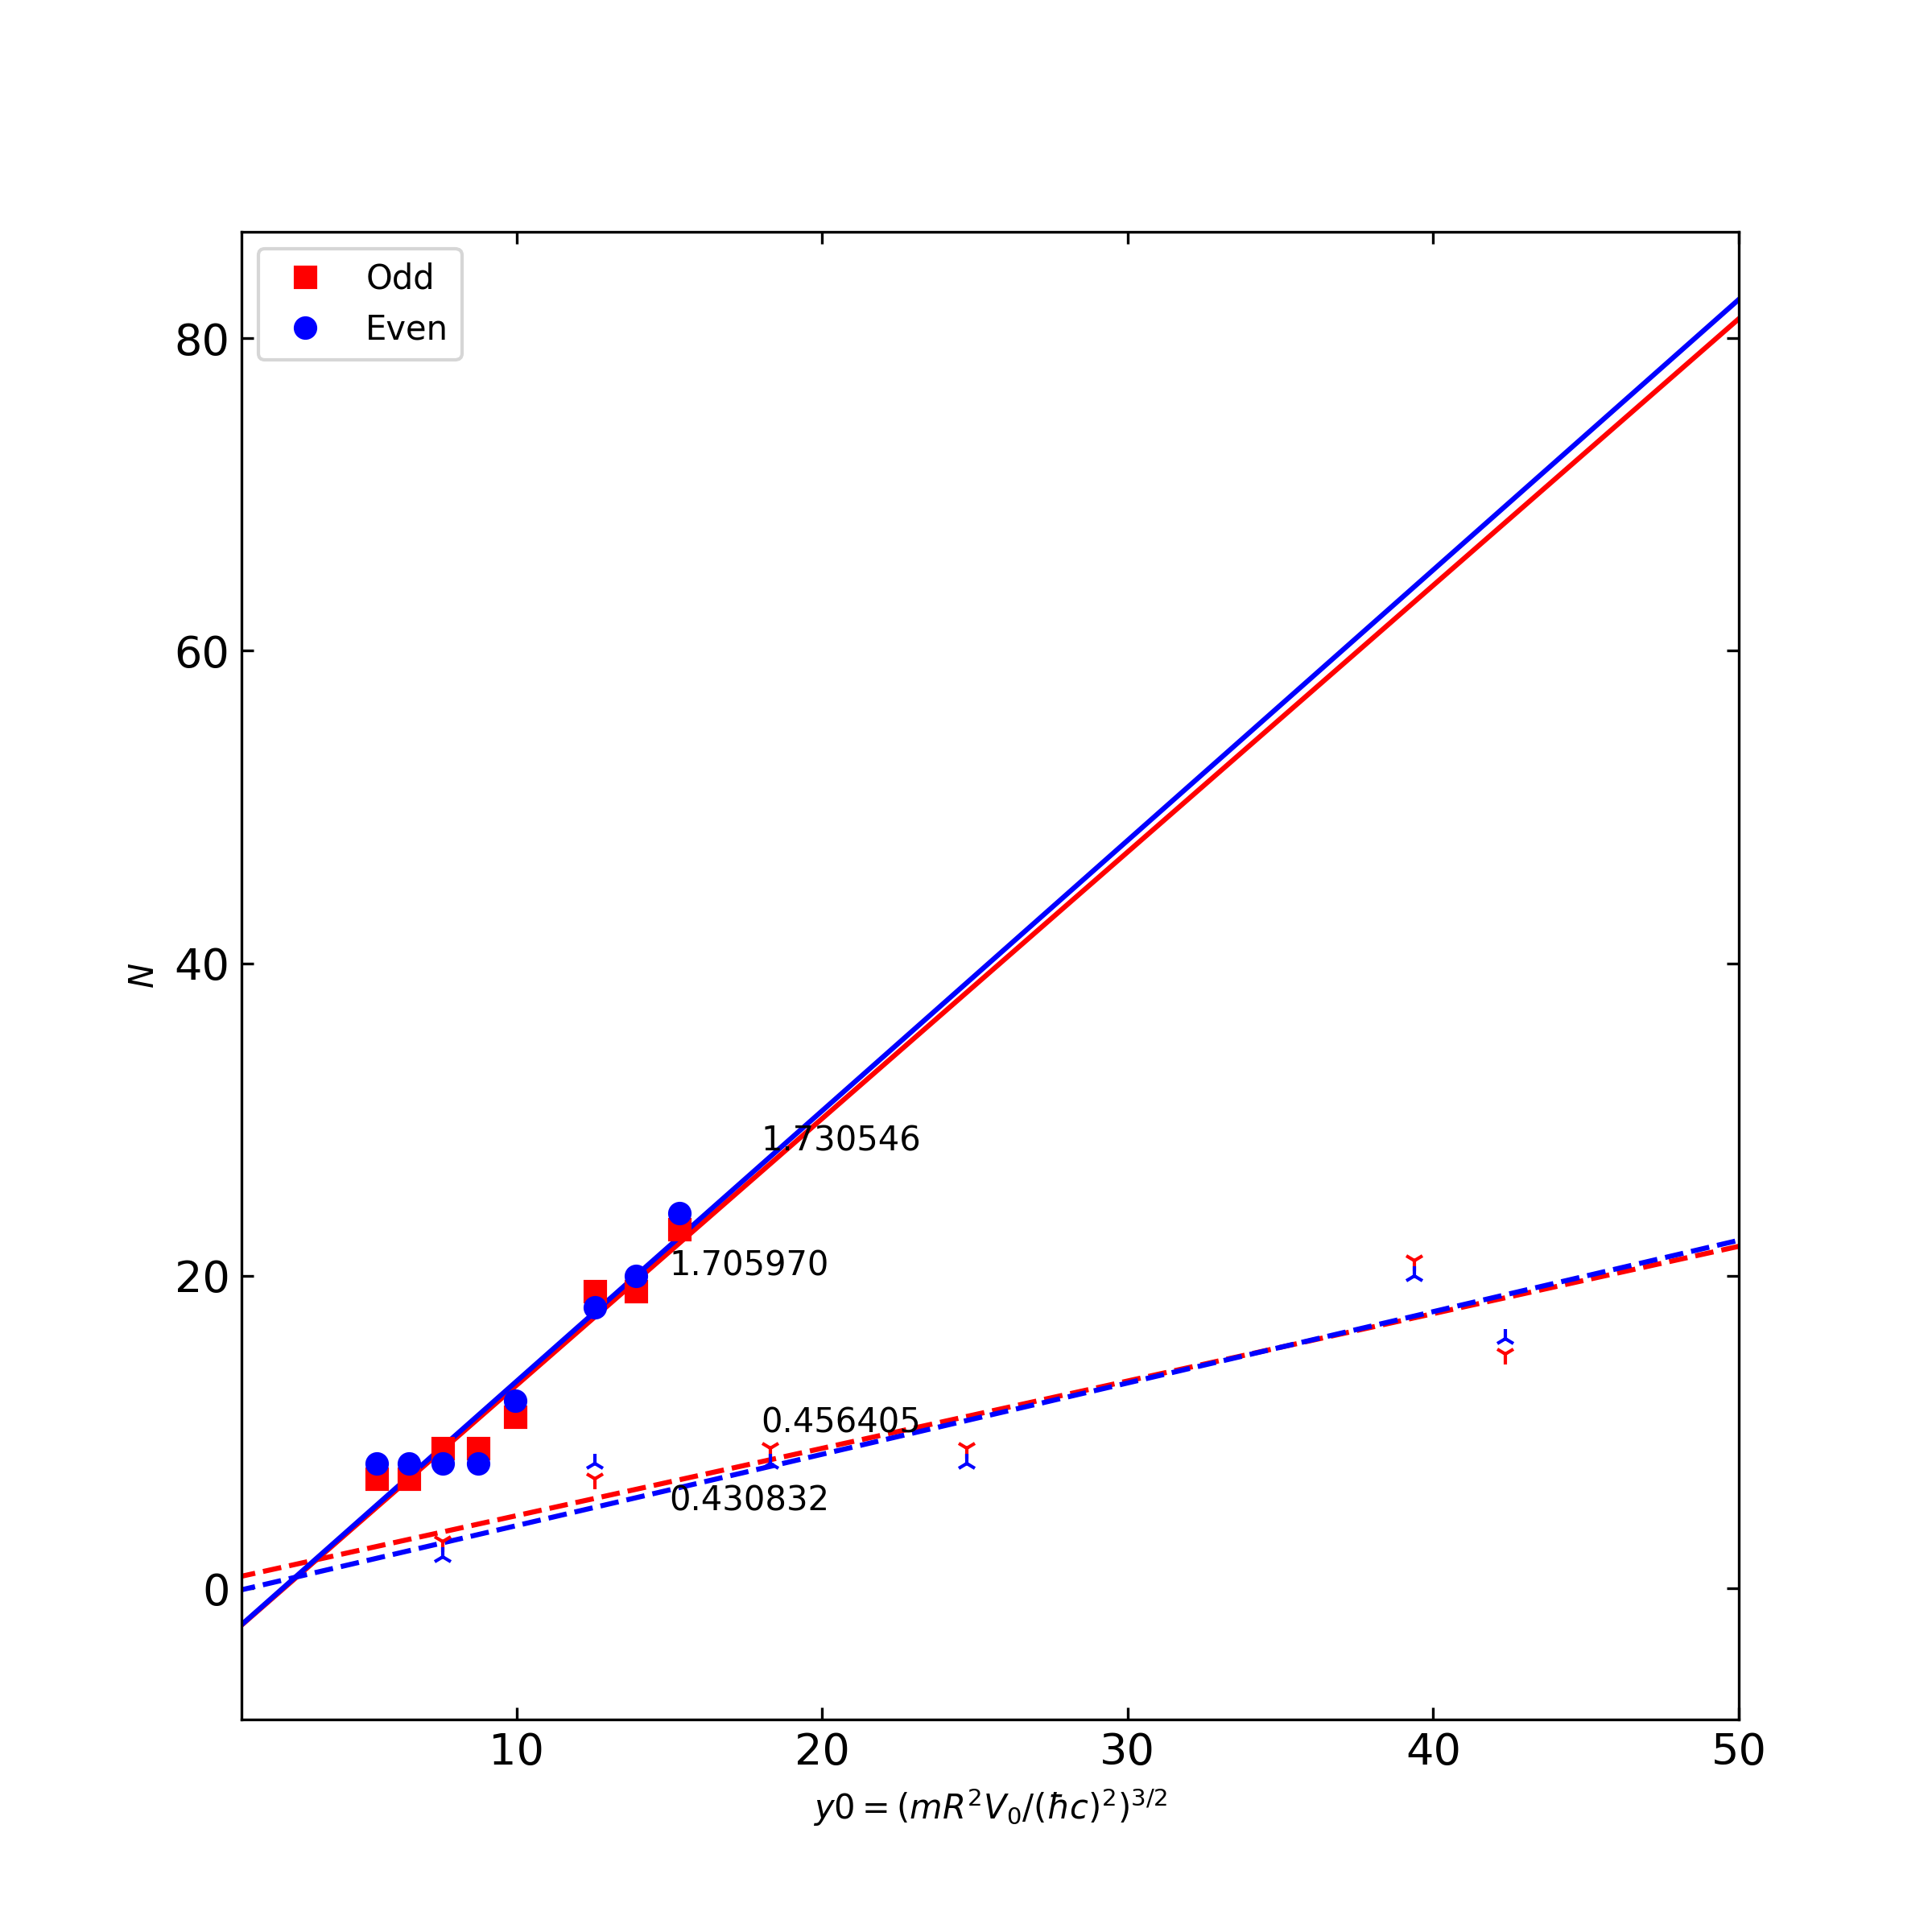
4. Works in Progress
Preliminary

Slide 24
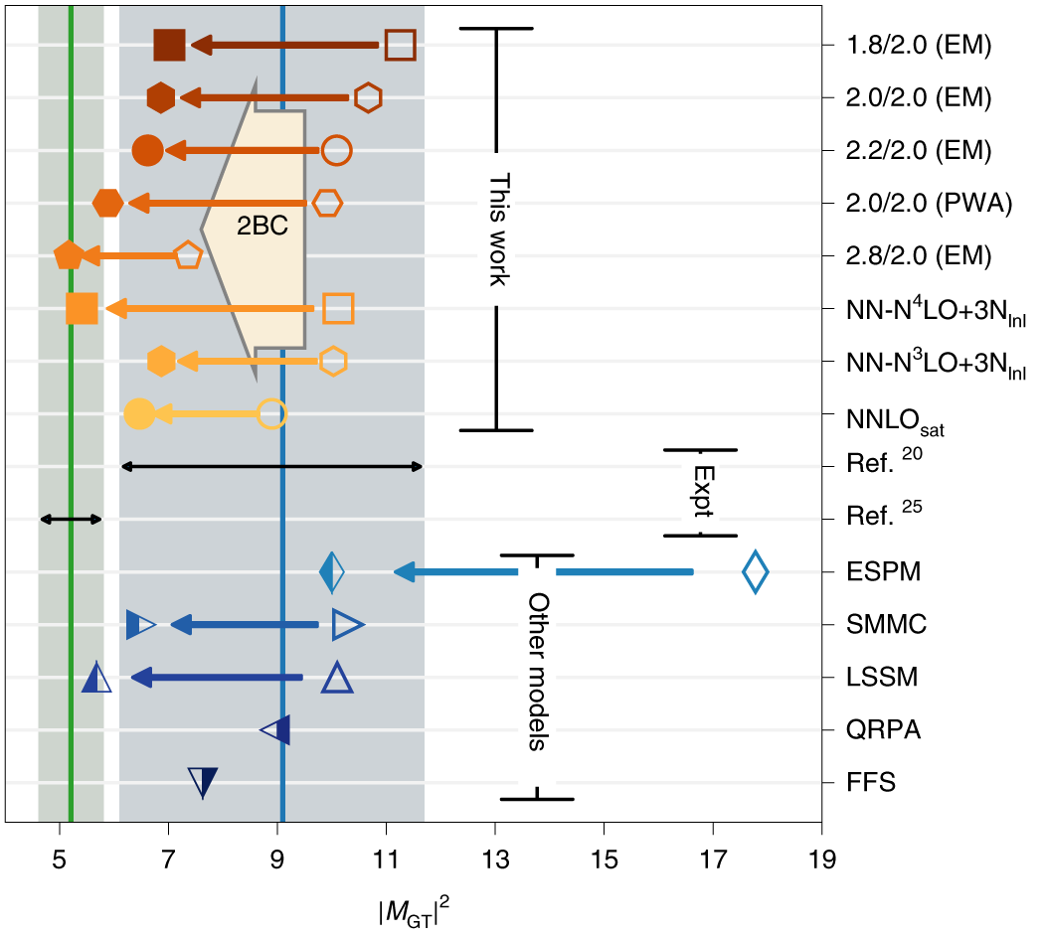
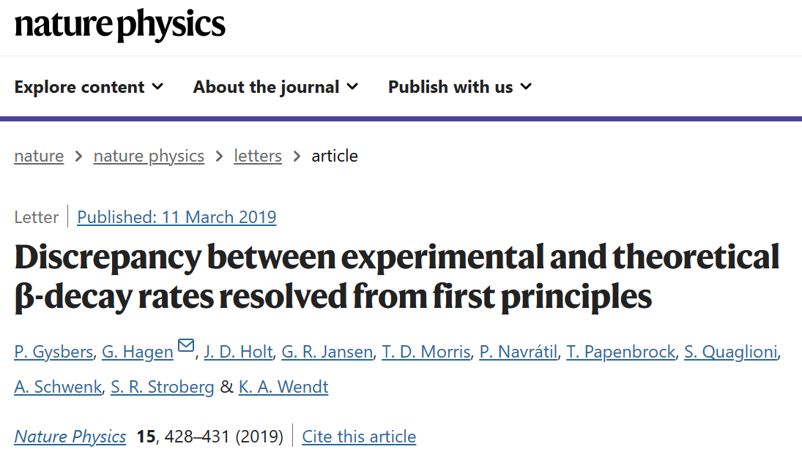

4. Works in Progress
Working on the G-T transition amplitude

Slide 25
4. Works in Progress
Difficulty in transition amplitude calculation in NLEFT
Needs Two nuclei at the same time
Sampling of auxiliary fields for off-diagonal matrix element
→ Re-weighting method
→ Mixed-Sampling method

Slide 26
5. Summary
Wave function matching method seems to be promising
New method to improve the N3LO calculation of NLEFT
Preliminary study shows promising results for wide range of observables in one scheme (same interaction and many-body method)
NN scattering
Binding energy (from 3H to 40Ca)
Symmetric Nuclear matter
Neutron matter
Dripline of Oxygen isotope.
Carbon excited states
Cluster structure, excited states will be studied.
Working on Unitary Fermion Gas under trap for dripline study
Working on G-T transition amplitude for the application to transition/reaction.

